Slide 1



SeGraM: A Universal Hardware Accelerator for Genomic Sequence-to-Graph and Sequence-to-Sequence Mapping
Damla Senol Cali, Ph.D.
damlasenolcali@gmail.com
https://damlasenolcali.github.io/
Konstantinos Kanellopoulos, Joel Lindegger, Zulal Bingol, Gurpreet S. Kalsi, Ziyi Zuo, Can Firtina, Meryem Banu Cavlak, Jeremie S. Kim, Nika Mansouri Ghiasi,
Gagandeep Singh, Juan Gomez-Luna, Nour Almadhoun Alserr, Mohammed Alser, Sreenivas Subramoney, Can Alkan, Saugata Ghose, Onur Mutlu
Notes:
Hello, I am Damla Senol Cali. Today, I'll be presenting our work “SeGraM: A Universal Hardware Accelerator for Genomic Sequence-to-Graph and Sequence-to-Sequence Mapping ".

Slide 2
Genome Sequencing
Genome sequencing: Enables us to determine the order of the DNA sequence in an organism’s genome
Plays a pivotal role in:
Personalized medicine
Outbreak tracing
Understanding of evolution
Modern genome sequencing machines extract smaller randomized fragments of the original DNA sequence, known as reads
Short reads: a few hundred base pairs, error rate of ∼0.1%
Long reads: thousands to millions of base pairs, error rate of 10–15%
Notes:
[CLICK] Genome sequencing, which enables us to determine the DNA sequence of an organism, [CLICK] plays a pivotal role in areas such as personalized medicine, outbreak tracing (like COVID-19), and the understanding of evolution.
[CLICK] Modern genome sequencing machines extract small randomized fragments of the original DNA sequence, which we call reads.
[CLICK] State-of-the-art sequencing machines produce either short reads or long reads

Slide 3
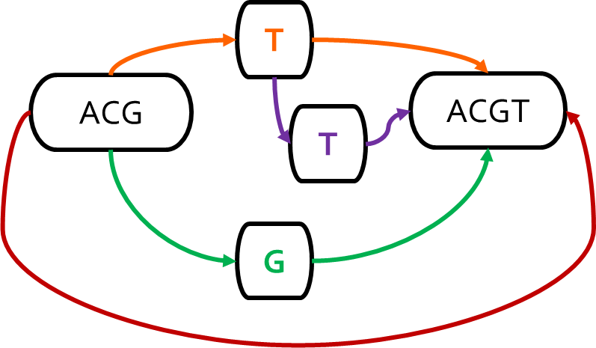
Genome Sequence Analysis
Mapping the reads to a reference genome (i.e., read mapping) is a critical step in genome sequence analysis
Sequence-to-Sequence (S2S) Mapping
Sequence-to-Graph (S2G) Mapping
Linear Reference: ACGTACGT
Read: ACGG
Alternative Sequence: ACGGACGT
Alternative Sequence: ACGTTACGT
Alternative Sequence: ACG‒ACGT
Graph-based Reference:
Read: ACGG
Sequence-to-graph mapping results in notable quality improvements.
However, it is a more difficult computational problem,
with no prior hardware design.
Notes:
Read mapping, which is the process of mapping the reads to a reference genome is a critical step in genome sequence analysis
Traditionally, we perform seq2seq mapping, where we
Map reads collected from an individual to a known linear reference genome sequence
Emphasizes the genetic variations that are present in the single reference genome
Ignores other variations that are not represented in the single linear reference sequence
Introduces reference bias
However, s2s mapping is a well studied problem with many available tools and accelerators
Recent works replace the linear reference sequence with a graph-based representation of the reference genome (genome graph). Thus, we can perform seq2graph mapping.
Captures the genetic variations and diversity across many individuals in a population
[CLICK] Results in notable quality improvements in GSA

Slide 4
SeGraM: First Graph Mapping Accelerator
Our Goal:
Specialized, high-performance, scalable, and low-cost algorithm/hardware co-design that alleviates bottlenecks in multiple steps of sequence-to-graph mapping
SeGraM: First universal algorithm/hardware co-designed genomic mapping accelerator that can effectively and efficiently support:
Sequence-to-graph mapping
Sequence-to-sequence mapping
Both short and long reads
Notes:
[CLICK] Thus, our goal is to come up with a specialized, high-performance, scalable, and low-cost algorithm/hardware co-design that alleviates bottlenecks in both the seeding and alignment steps of sequence-to-graph mapping.
[CLICK] To this end, we propose SeGraM, a universal algorithm/hardware co-designed genomic mapping accelerator that can effectively and efficiently support both sequence-to-graph mapping and sequence-to-sequence mapping, for both short and long reads. To our knowledge, SeGraM is the first algorithm/hardware co-design for accelerating
sequence-to-graph mapping.

Slide 5
Use Cases & Key Results
Sequence-to-Graph (S2G) Mapping
5.9×/106× speedup, 4.1×/3.0× less power than GraphAligner for long and short reads, respectively (state-of-the-art SW)
3.9×/742× speedup, 4.4×/3.2× less power than vg for long and short reads, respectively (state-of-the-art SW)
Sequence-to-Graph (S2G) Alignment
41×–539× speedup over PaSGAL with AVX-512 support (state-of-the-art SW)
Sequence-to-Sequence (S2S) Alignment
1.2×/4.8× higher throughput than GenASM and GACT of Darwin for long reads (state-of-the-art HW)
1.3×/2.4× higher throughput than GenASM and SillaX of GenAX for short reads (state-of-the-art HW)
Notes:
[CLICK] [CLICK] [CLICK] We demonstrate that SeGraM provides significant improvements for multiple steps of the sequence-to-graph (i.e., S2G) and sequence-to-sequence (i.e., S2S) mapping pipelines.
==================================================================================================================
[CLICK] We show that (1) SeGraM provides greatly higher throughput and lower power consumption on both short and long reads compared to state-of-the-art software tools for sequence-to-graph mapping, and
[CLICK] (2) BitAlign significantly outperforms a state-of-the-art sequence-to-graph alignment tool and [CLICK] three state-of-the-art hardware solutions that are specifically designed for sequence-to-sequence alignment.
===========================================================================================================
We also show that MinSeed can be employed for the seeding step of both sequence-to-graph and sequence-to-sequence mapping pipelines.

Slide 6
Outline
Introduction
Background
Genome Graphs
Sequence-to-Graph Mapping
SeGraM: Universal Genomic Mapping Accelerator
High-Level Overview
MinSeed
BitAlign
Use Cases
Evaluation
Conclusion
Notes:
Let’s look at genome graphs and sequence-to-graph mapping in detail.

Slide 7
Genome Graphs
Genome graphs:
Combine the linear reference genome with the known genetic variations in the entire population as a graph-based data structure
Enable us to move away from aligning with a single linear reference genome (reference bias) and more accurately express the genetic diversity in a population
Sequence #1: ACGTACGT
ACGTACGT
Notes:
[CLICK] Genome graphs are better suited for expressing the genomic regions that have variations than a linear reference sequence since genome graphs combine the linear reference genome with the known genetic variations in the entire population as a graph-based data structure.
[CLICK] Genome graphs enable us to remove the reference bias that using a single reference genome introduces by ignoring the variations that are not represented in the single linear reference sequence. Therefore, there is a growing trend towards using genome graphs to more accurately express the genetic diversity in a population.
[CLICK] Let’s look at an example.

Slide 8
Genome Graphs
Genome graphs:
Combine the linear reference genome with the known genetic variations in the entire population as a graph-based data structure
Enable us to move away from aligning with a single linear reference genome (reference bias) and more accurately express the genetic diversity in a population
Sequence #1: ACGTACGT
Sequence #2: ACGGACGT
ACGTACGT

Slide 9
Genome Graphs
Genome graphs:
Combine the linear reference genome with the known genetic variations in the entire population as a graph-based data structure
Enable us to move away from aligning with a single linear reference genome (reference bias) and more accurately express the genetic diversity in a population
T
Sequence #1: ACGTACGT
Sequence #2: ACGGACGT
ACG
ACGT
G

Slide 10
Genome Graphs
Genome graphs:
Combine the linear reference genome with the known genetic variations in the entire population as a graph-based data structure
Enable us to move away from aligning with a single linear reference genome (reference bias) and more accurately express the genetic diversity in a population
T
Sequence #1: ACGTACGT
Sequence #2: ACGGACGT
Sequence #3: ACGTTACGT
ACG
ACGT
G

Slide 11
Genome Graphs
Genome graphs:
Combine the linear reference genome with the known genetic variations in the entire population as a graph-based data structure
Enable us to move away from aligning with a single linear reference genome (reference bias) and more accurately express the genetic diversity in a population
T
Sequence #1: ACGTACGT
Sequence #2: ACGGACGT
Sequence #3: ACGTTACGT
ACG
ACGT
T
G

Slide 12
Genome Graphs
Genome graphs:
Combine the linear reference genome with the known genetic variations in the entire population as a graph-based data structure
Enable us to move away from aligning with a single linear reference genome (reference bias) and more accurately express the genetic diversity in a population
T
Sequence #1: ACGTACGT
Sequence #2: ACGGACGT
Sequence #3: ACGTTACGT
Sequence #4: ACGACGT
ACG
ACGT
T
G

Slide 13
Genome Graphs
Genome graphs:
Combine the linear reference genome with the known genetic variations in the entire population as a graph-based data structure
Enable us to move away from aligning with a single linear reference genome (reference bias) and more accurately express the genetic diversity in a population
T
Sequence #1: ACGTACGT
Sequence #2: ACGGACGT
Sequence #3: ACGTTACGT
Sequence #4: ACGACGT
ACG
ACGT
T
G
Notes:
With increasing importance and usage of genome graphs, having accurate and efficient tools for mapping genomic sequences to these genome graphs has become crucial. [CLICK]

Slide 14
Sequence-to-Graph Mapping Pipeline
0.1
Pre-Processing
Steps (Offline)
Seed-and-Extend
Steps (Online)
Linear reference genome
Known genetic variations
Genome Graph Construction
(construct the graph using a linear reference genome and variations)
Genome graph
0.2
Indexing
(index the nodes of the graph)
Hash-table-based index (of graph nodes)
Reads from sequenced
genome
1
Seeding
(query the index & find the seed matches)
Candidate mapping locations (subgraphs)
2
Filtering/Chaining/Clustering
(filter out dissimilar query read and subgraph pairs)
Remaining candidate mapping locations (subgraphs)
3
S2G Alignment
(perform distance/score calculation & traceback)
Optimal alignment between read & subgraph
Notes:
Which brings us to seq2graph mapping.
Sequence-to-graph mapping pipeline has [CLICK] two pre-processing and [CLICK] three main steps.
[CLICK] The first pre-processing step constructs the genome graph using a linear reference genome and the associated variations for that genome.
[CLICK] The second pre-processing step indexes the nodes of the graph. The resulting index is used in the first main step of the pipeline, [CLICK] seeding, which aims to find seed matches between the query read and a region of the graph.
[CLICK] After optionally filtering these seed matches with a filtering, chaining, or clustering step, [CLICK] alignment is performed between all of the non-filtered seed locations within the graph and the query read to find the optimal alignment. Alignment is the most expensive step of the pipeline, so let’s look at it in detail.

Slide 15
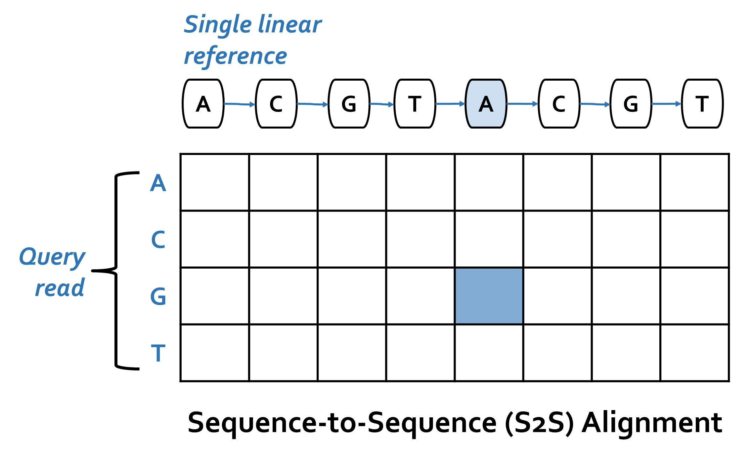
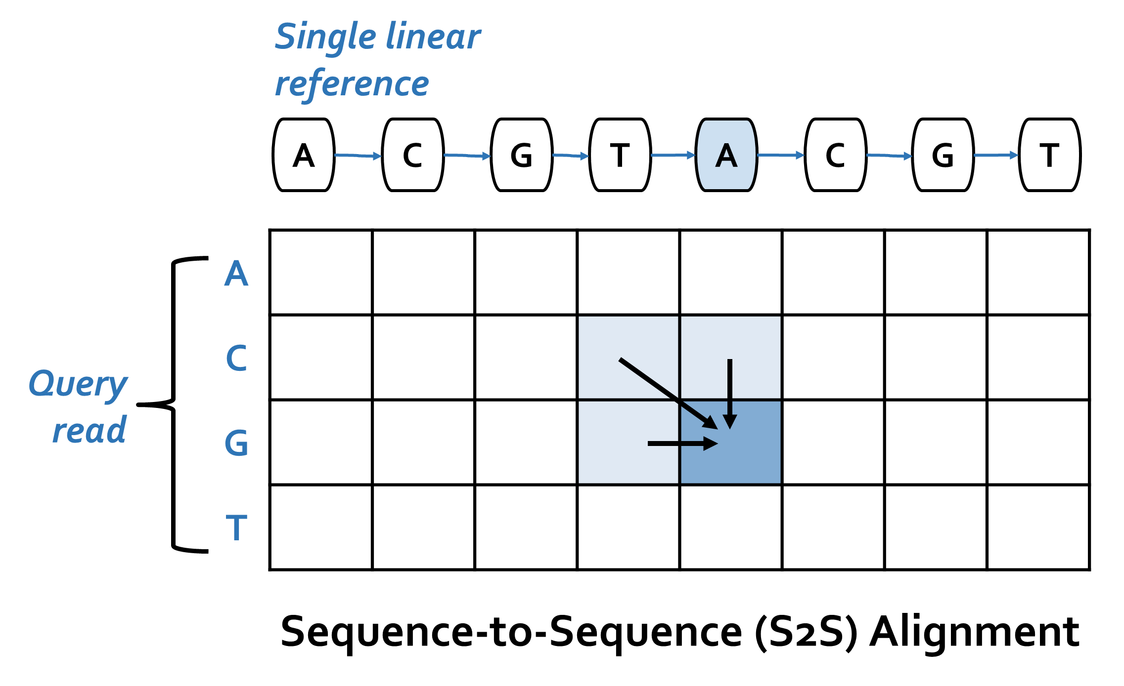
S2S vs. S2G Alignment
Notes:
[CLICK] Traditional sequence-to-sequence (S2S) alignment typically employs DP-based algorithms with quadratic time and space complexity.
A DP-based algorithm operates on a table, where each column of the table corresponds to a reference character, and each row of the table corresponds to a query read character.
[HIGHLIGHT] In S2S alignment, a new cell in the table is determined with simple rules from 3 of its neighbor cells.

Slide 16
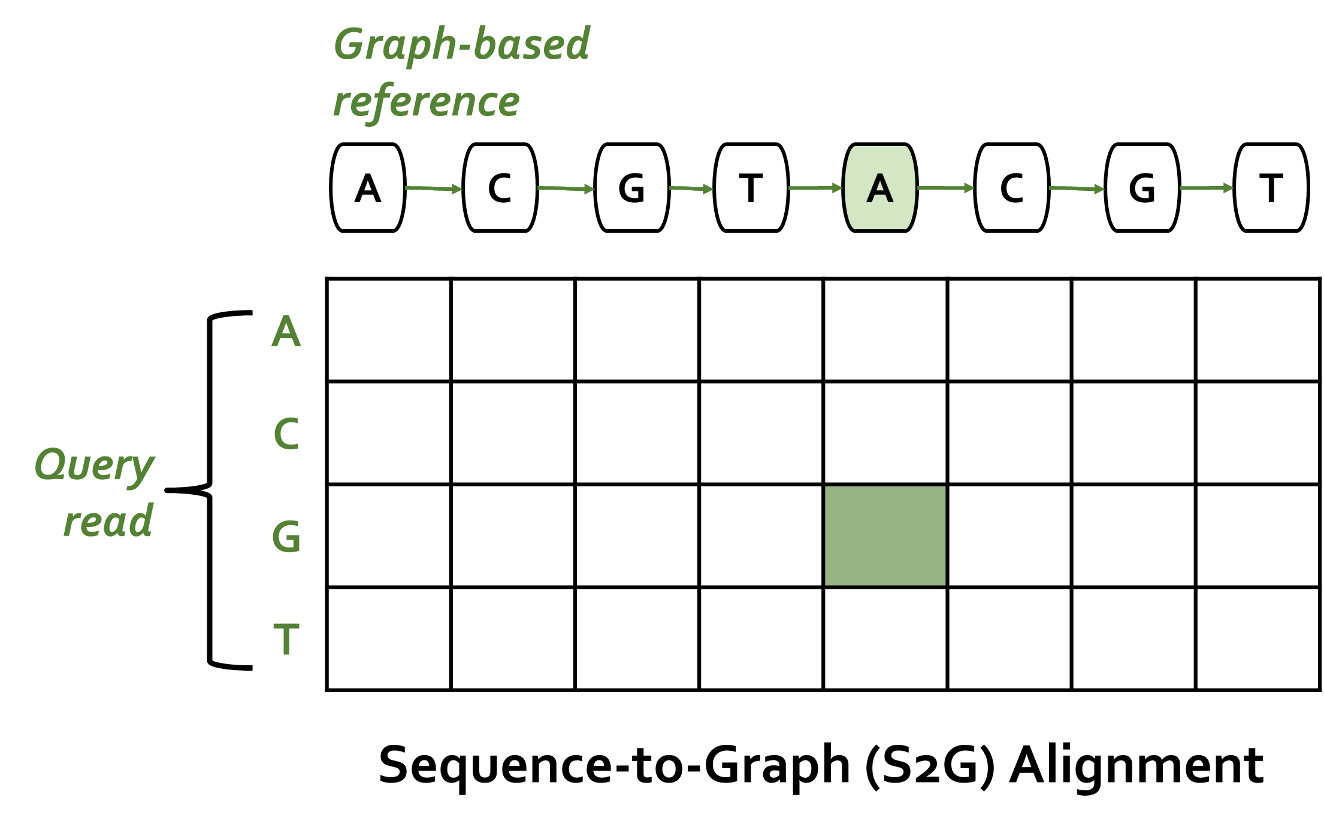
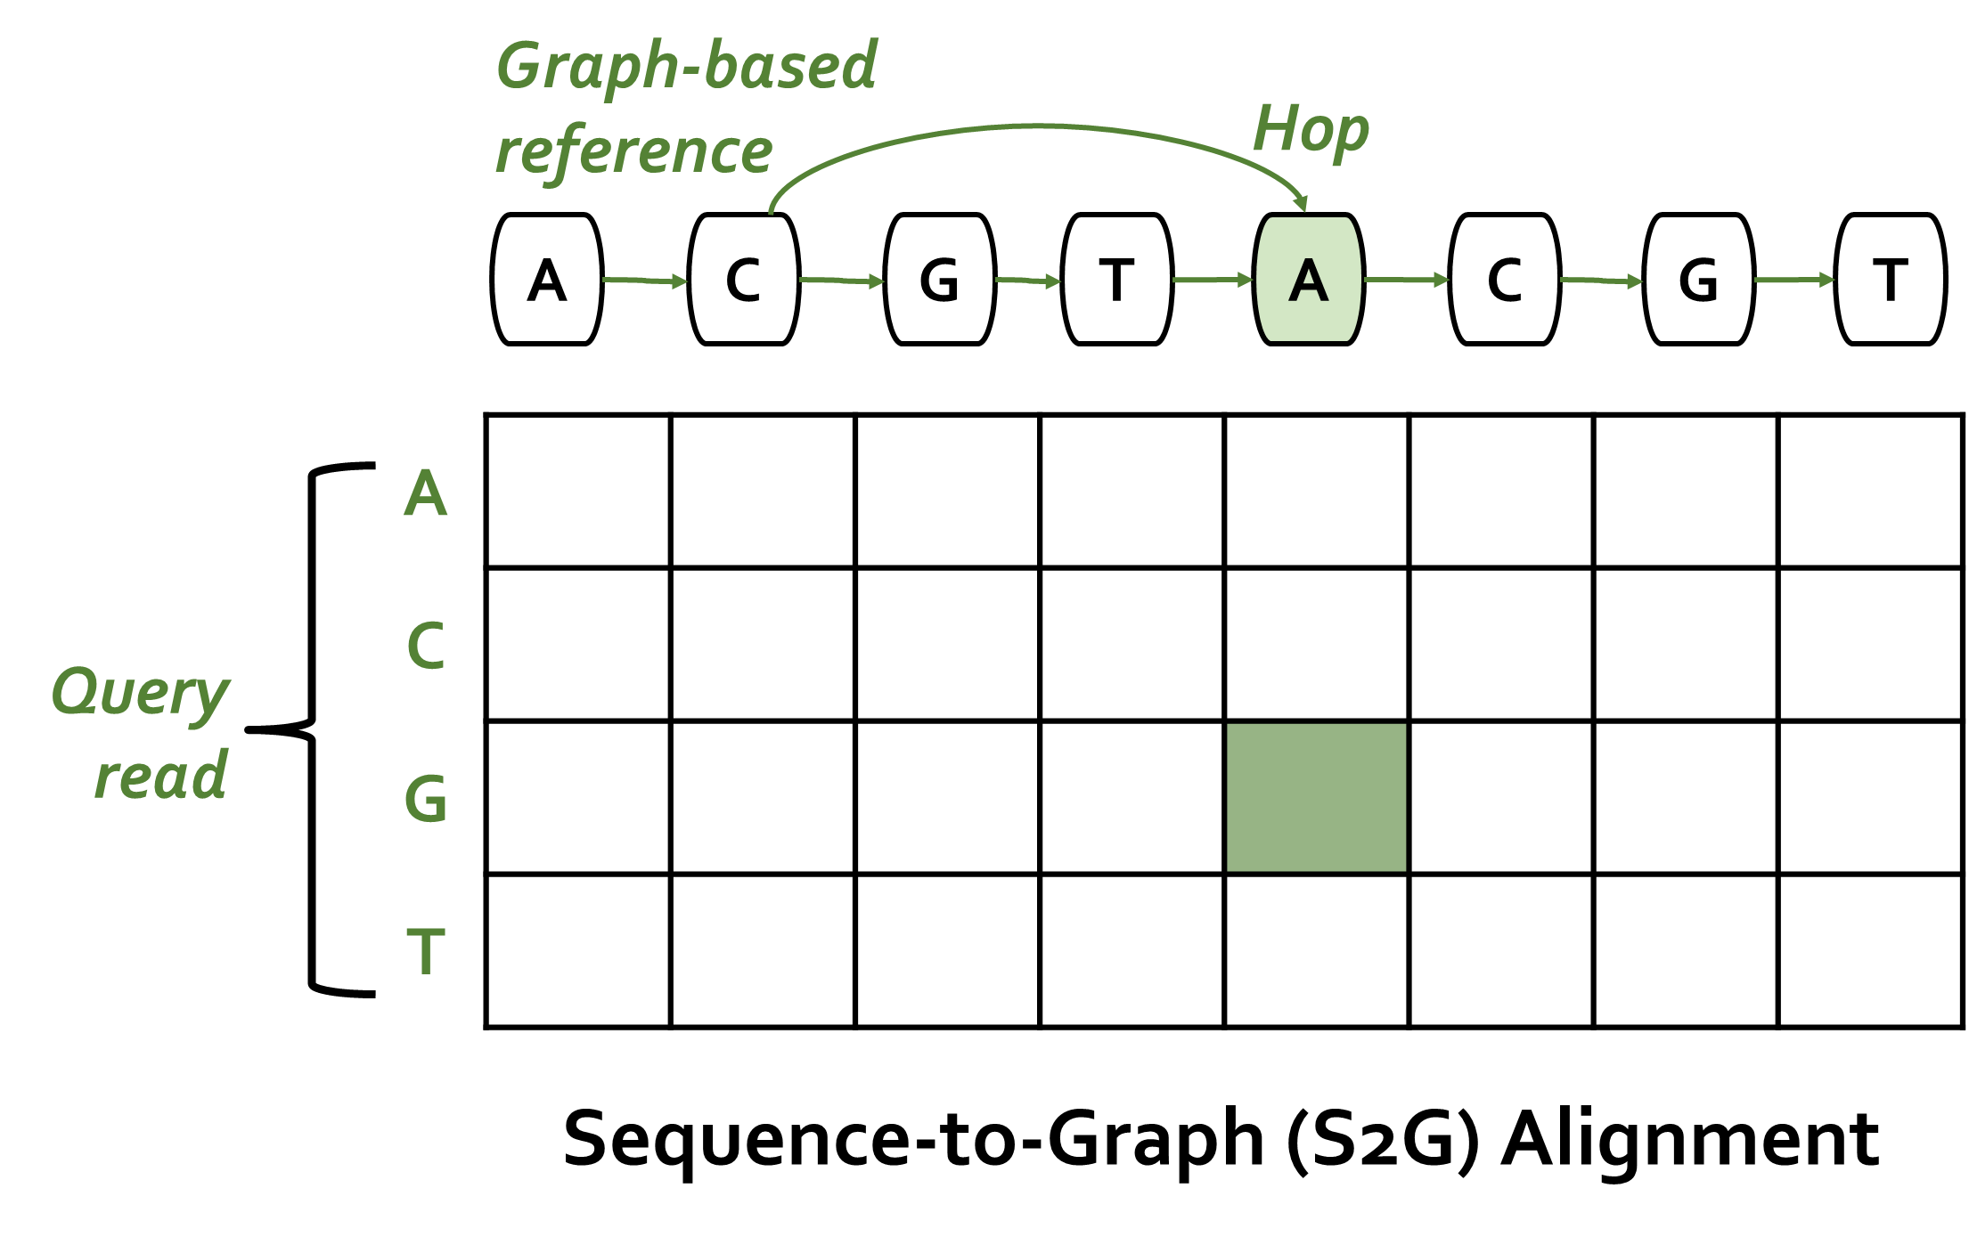
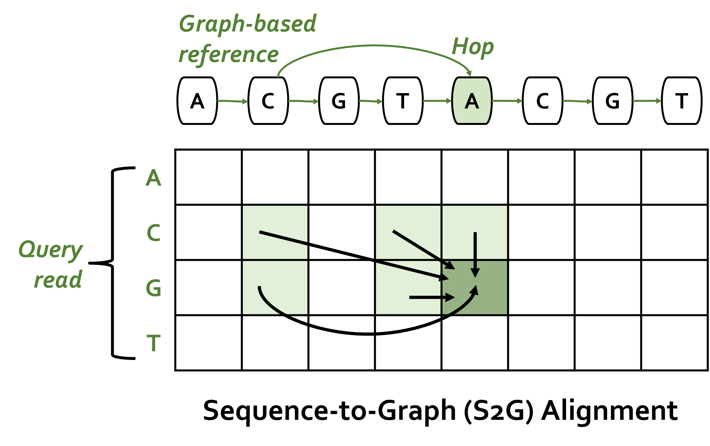
S2S vs. S2G Alignment
In contrast to S2S alignment,
S2G alignment must incorporate non-neighboring characters
as well whenever there is an edge (i.e., hop)
from the non-neighboring character to the current character
Notes:
[CLICK] In contrast to S2S alignment, S2G alignment must incorporate non-neighboring characters as well whenever there is an edge (i.e., hop) from the non-neighboring character to the current character. [HIGHLIGHT] For example, when computing the green-shaded cell, we need information from all of the light green-shaded cells.
=======================================================================================================
Even though sequence-to-sequence mapping is a well-studied problem, given the additional complexities and overheads of processing a genome graph instead of a linear reference genome, sequence-to-graph mapping is a more difficult computational problem with a smaller number of practical software tools currently available.

Slide 17
Analysis of State-of-the-Art Tools
SW
Based on our analysis with GraphAligner and vg:
Observation 1: Alignment step is the bottleneck
Observation 2: Alignment suffers from high cache miss rates
Observation 3: Seeding suffers from the DRAM latency bottleneck
Observation 4: Baseline tools scale sublinearly
Observation 5: Existing S2S mapping accelerators are unsuitable for the S2G mapping problem
Observation 6: Existing graph accelerators are unable to handle S2G alignment
HW
Notes:
In order to further understand the performance bottlenecks of the state-of-the-art sequence-to-graph mapping tools, we rigorously analyze two such tools, GraphAligner [61] and vg [36], and we make four key observations.
[CLICK] (1) Among the three online steps of the read mapping pipeline alignment i) constitutes majority of the end-to-end execution of sequence-to-graph mapping, and ii) is even more expensive than its counterpart in the traditional read mapping pipeline.
[CLICK] (2) Alignment suffers from high cache miss rates, due to the high amount of internal data that is generated and reused during this step.
[CLICK} (3) Seeding suffers from the main memory (DRAM) latency bottleneck, due to the high number of irregular memory accesses.
[CLICK] (4) Both state-of-the-art tools scale sublinearly as thread count increases, wasting available thread-level parallelism in hardware.
[CLICK] We also investigate the existing HW accelerators. It is important to note that there is no existing hardware accelerator for sequence-to-graph mapping or alignment problems.
[CLICK] Even though there are several hardware accelerators designed to alleviate bottlenecks in several steps of traditional sequence-to-sequence (S2S) mapping, none of these
designs can be directly employed for the sequence-to-graph (S2G) mapping problem. This is because S2S mapping is a special case of S2G mapping, where all nodes have only one incoming edge. Existing accelerators are limited to only this special case, and are unsuitable for the more general S2G mapping problem, where we also need to consider multiple edges (i.e., hops) that a node can have.
[CLICK] We also look at the possibility of exploiting existing several graph accelerators. While existing graph accelerators could potentially be customized to help the seeding step of the sequence-to-graph mapping pipeline, they are unable to handle the major bottleneck of sequence-to-graph mapping, which is alignment. Alignment is not a graph traversal workload, and instead is an expensive bitvector-based or DP-based computational problem.
Thus, we need to have a specialized, balanced, and scalable design for compute units, on-chip memory, and main memory accesses for both the seeding and alignment steps of sequence-to-graph mapping.

Slide 18
Outline
Introduction
Background
Genome Graphs
Sequence-to-Graph Mapping
SeGraM: Universal Genomic Mapping Accelerator
High-Level Overview
MinSeed
BitAlign
Use Cases
Evaluation
Conclusion
Notes:
To this end, we propose SeGraM…

Slide 19
SeGraM: Universal Genomic Mapping Accelerator
First universal genomic mapping accelerator that can support both sequence-to-graph mapping and sequence-to-sequence mapping, for both short and long reads
First algorithm/hardware co-design for accelerating sequence-to-graph mapping
We base SeGraM upon a minimizer-based seeding algorithm
We propose a novel bitvector-based alignment algorithm to perform approximate string matching between a read and a graph-based reference genome
We co-design both algorithms with high-performance, scalable, and efficient hardware accelerators
SW
HW
Notes:
[CLICK] the first universal genomic mapping accelerator that can support both sequence-to-graph mapping and sequence-to-sequence mapping, for both short and
long reads.
[CLICK] To our knowledge, SeGraM is the first algorithm/hardware co-design for accelerating sequence-to-graph mapping.
[CLICK] We base SeGraM upon a minimizer-based seeding algorithm and we propose a novel bitvector-based alignment algorithm for sequence-to-graph alignment.
[CLICK] these cover the algorithmic contributions of SeGraM
[CLICK] We co-design both algorithms with high-performance, scalable, and efficient hardware accelerators.
[CLICK] and this covers the hardware-level contributions of SeGraM

Slide 20
SeGraM Hardware Design
Main Memory (graph-based reference & index)
SeGraM Accelerator
MinSeed (MS)
BitAlign (BA)
MinSeed (MS)
BitAlign (BA)
Minimizer Scratchpad
Seed Scratchpad
Input Scratchpad
Minimizer Scratchpad
Seed Scratchpad
Input Scratchpad
Generate Bitvectors
Hop Queues
Generate Bitvectors
Hop Queues
Find Minimizers
Filter
Minimizers by Frequency
Find Candidate
Seed Regions
Find Minimizers
Filter
Frequencies by Frequency
Find Candidate
Seed Regions
Bitvector Scratchpad
Bitvector Scratchpad
Host CPU
Read
Scratchpad
Perform
Traceback
Read
Scratchpad
Perform
Traceback
MinSeed: first hardware
accelerator for
Minimizer-based Seeding
BitAlign: first hardware accelerator for (Bitvector-based) sequence-to-graph Alignment
Notes:
A SeGraM accelerator consists of two main components:
[CLICK] MinSeed (MS), which is responsible for the seeding step and it is the first hardware accelerator for minimizer-based seeding, and second component is
[CLICK] (2) BitAlign (BA), which is responsible for the alignment step and it is the first hardware accelerator for sequence-to-graph alignment.

Slide 21
SeGraM Hardware Design
Main Memory (graph-based reference & index)
Main Memory (graph-based reference & index)
frequencies
seed locations
graph nodes
3
5
7
SeGraM Accelerator
MinSeed (MS)
BitAlign (BA)
Minimizer Scratchpad
Seed Scratchpad
Input Scratchpad
8
Generate Bitvectors
Hop Queues
9
minimizers
2
4
6
Find Minimizers
Filter
Minimizers by Frequency
Find Candidate
Seed Regions
10
Bitvector Scratchpad
query k-mers
Host CPU
Host CPU
11
1
Read
Scratchpad
Perform
Traceback
query
read
optimal alignment information
12
MinSeed: first hardware
accelerator for
Minimizer-based Seeding
BitAlign: first hardware accelerator for (Bitvector-based) sequence-to-graph Alignment
Notes:
Let’s look at the overview of our hardware design.
[CLICK] Before SeGraM execution starts, as pre-processing steps, we (1) generate each chromosome’s graph structure, (2) index each graph’s nodes, and (3) pre-load both the resulting graph and hash table index into the main memory. Both the graph and its index are static data structures that can be generated only once and reused for multiple mapping executions.
[CLICK] SeGraM execution starts when the query read is streamed from the host and MinSeed writes it to the read scratchpad ( 1 ).
[CLICK] Using all of the k-length subsequences (i.e., k-mers) of the query read, [CLICK] MinSeed finds the minimum representative set of these k-mers (i.e., minimizers) according to a scoring mechanism and [CLICK] writes them to the minimizer scratchpad ( 2 ).
[CLICK] For each minimizer, MinSeed fetches its occurrence frequency from the hash table in main memory ( 3 ) and [CLICK] filters out each minimizer whose occurrence frequency is above a user-defined threshold ( 4 ). We aim to select the least frequent minimizers and filter out the most frequent minimizers such that we minimize the number of seed locations to be considered for the expensive alignment step.
[CLICK] Next, MinSeed fetches the seed locations of the remaining minimizers from main memory, and writes them to the seed scratchpad ( 5 ).
[CLICK] Finally, MinSeed calculates the candidate reference region (i.e., subgraph surrounding the seed) for each seed ( 6 ), [CLICK] fetches the graph nodes from memory for each candidate region in the reference and writes the nodes to the input scratchpad of BitAlign. ( 7 ).
[CLICK] BitAlign starts by reading the subgraph and the query read from the input scratchpad, and generates the bitvectors ( 8 ) required for performing approximate string matching and edit distance calculation.
While generating these bitvectors, [CLICK] BitAlign writes them to the hop queues ( 9 ) in order to handle the hops required for graph-based alignment, and also, [CLICK] to the bitvector scratchpad ( 10 ) to be later used as part of the traceback operation.
Once BitAlign finishes generating and writing all the bitvectors, [CLICK] it starts reading them back from the bitvector scratchpad, performs the traceback operation ( 11 ), finds the optimal alignment between the subgraph and the query read, and [CLICK] streams the optimal alignment information back to the host ( 12 ).

Slide 22
MinSeed HW
MinSeed = 3 computation modules + 3 scratchpads + memory interface
Computation modules: Implemented with simple logic
Scratchpads: 50kB in total; employ double buffering technique to hide the latency of MinSeed
High-Bandwidth Memory (HBM): Enables low-latency and highly-parallel memory access
Main Memory (High Bandwidth Memory)
Main Memory (High Bandwidth Memory)
Read
Scratchpad
(6 kB)
Minimizer
Finder
Minimizer Scratchpad
(40 kB)
Minimizer Filter
by
Frequency
(<?)
Seed Scratchpad
(4 kB)
Candidate
Seed Region
Calculator
(+/−/×)
Read
Scratchpad
(6 kB)
Minimizer
Finder
Minimizer Scratchpad
(40 kB)
Minimizer Filter
by
Frequency
(<?)
Seed Scratchpad
(4 kB)
Candidate
Seed Region
Calculator
(+/−/×)
query read
(INPUT)
candidate
subgraph
(OUTPUT)
frequency
threshold
(INPUT)
error rate,
read length
(INPUT)
Notes:
Let’s look at the HW design of MinSeed.
MinSeed accelerator consists of three computation modules, three scratchpads, and the memory interface
Computation modules are implemented with simple logic, since we require only basic operations (e.g., comparisons, simple arithmetic operations, scratchpad R/W operations)
For all three scratchpads, we employ a double buffering technique to hide the latency of the MinSeed accelerator.
We couple MinSeed with High-Bandwidth Memory (HBM) to enable low-latency and highly-parallel memory access.

Slide 23
BitAlign HW
Linear cyclic systolic array-based accelerator
Based on the GenASM hardware design*
Incorporates hop queue registers to feed the bitvectors of non-neighboring characters/nodes (i.e., hops)
Bitvector Scratchpad_{x}
Bitvector Scratchpad_{x+1}
HopQueueRegister_{x-1}
HopQueueRegister_{x}
HopQueueRegister_{x+1}
R[d]
R[d]
oldR[d-1]
oldR[d]
oldR[d-1]
oldR[d]
PC
R[d-1]
PC
PatternBitmask
HopBits
PE_{x}
PE_{x+1}
[*] D. Senol Cali et al. "GenASM: A High-Performance, Low-Power Approximate String Matching Acceleration Framework for Genome Sequence Analysis” (MICRO’20)
Notes:
Let’s look at the HW design of BitAlign.
[CLICK] We implement BitAlign as a linear cyclic systolic array based accelerator.
[CLICK] While this design is based on the GenASM hardware, where bitvectors are written to Bitvector Scratchpads during bitvector generation step for later use in traceback, [CLICK] our new design incorporates hop queue registers in order to feed the bitvectors of non-neighboring characters/nodes.

Slide 24

Overall System Design of SeGraM
High Bandwidth Memory (HBM2E) Stack
High Bandwidth Memory (HBM2E) Stack
. . .
CH1
. . .
CH0
CH2
CH6
CH7
SeGraM Module (1 x per HBM2E stack)
Host
SeGraM Module (1 x per HBM2E stack)
Host
MS
MS
MS
MS
MS
X
4
. . .
BA
BA
BA
BA
BA
SeGraM
Acc.
SeGraM
Acc.
SeGraM
Acc.
SeGraM
Acc.
SeGraM
Acc.
Notes:
[CLICK] SeGraM is connected to a host system that is responsible for the pre-processing steps and for transferring the query read to the accelerator.
[CLICK] Next to each HBM2E channel, we place one SeGraM accelerator, such that it will have exclusive access without any interference from other SeGraM accelerators.
[CLICK] Each SeGraM accelerator is a combination of one MinSeed accelerator and one BitAlign accelerator.
[CLICK] Each HBM2E stack has eight memory channels, thus connected to 8 SeGraM accelerators, which define one SeGraM module.
[CLICK] Our hardware platform includes four off-chip HBM2E stacks, thus 4 SeGraM modules, thus 32 SeGraM accelerators in total. ====================================================================================================================
Each SeGraM accelerator has exclusive access to one HBM2E channel to ensure low-latency memory access, without any interference from other SeGraM accelerators in each module.
There is no communication required between different SeGraM accelerators in a single SeGraM module, and each SeGraM accelerator communicates with the host independently of other SeGraM accelerators.
[CLICK] We replicate the graph-based reference and hash-table-based index across all 4 independent HBM2E stacks, which enables us to have 32 independent SeGraM accelerators running in parallel.
[CLICK] Within each stack, to balance the memory footprint across all channels, we distribute the graph and index structures of all chromosomes (1–22, X, Y) based on their sizes across the eight independent channels
[CLICK] We design each SeGraM accelerator (MinSeed + BitAlign) to operate in a pipelined fashion and we employ double buffering technique for all MS scratchpads, such that we can hide the latency of the MinSeed accelerator.

Slide 25
Use Cases of SeGraM
(1) Sequence-to-Graph
Mapping
(2) Sequence-to-Graph
Alignment
(3) Sequence-to-Sequence
Alignment
(4) Seeding
MS
BA
MS or
Other
BA
MS or
Other
BA
MS
BA or
Other
Notes:
As a result of the flexibility and modularity of the SeGraM framework, we can run each accelerator together or separately. Thus, we describe four use cases of SeGraM: [CLICK] (1) end-to-end mapping w/ SeGraM, [CLICK] (2) standalone s2g alignment w/ BitAlign and can be coupled with any seeding tool or accelerator, [CLICK] (3) similarly, standalone s2s alignment w/ BitAlign, and [CLICK] (4) standalone seeding for both s2g and s2s w/ MinSeed and can be coupled with any alignment tool or accelerator.
=========================================================================================================
[CLICK] For sequence-to-graph mapping, the whole SeGraM design (MinSeed + BitAlign) should be employed, since both seeding and alignment steps are required. With the help of the divide-and-conquer approach inherited from the GenASM algorithm, we can use SeGraM to perform sequence-to-graph mapping for both short reads and long reads.
[CLICK] Since BitAlign takes in a graph-based reference and a query read as its inputs, it can be used as a standalone sequence-to-graph aligner, without MinSeed. BitAlign is orthogonal to and can be coupled with any seeding (or filtering) tool/accelerator.
[CLICK] BitAlign can also be used for sequence-to-sequence alignment, as sequence-to-sequence alignment is a special and simpler variant of sequence-to-graph alignment. [CLICK] Similarly, MinSeed can be used without BitAlign as a standalone seeding accelerator for both graph-based mapping and traditional linear mapping. MinSeed is orthogonal to and can be coupled with any alignment tool or accelerator.

Slide 26
Outline
Introduction
Background
Genome Graphs
Sequence-to-Graph Mapping
SeGraM: Universal Genomic Mapping Accelerator
High-Level Overview
MinSeed
BitAlign
Use Cases
Evaluation
Conclusion
Notes:
Let’s look at our evaluation of the SeGraM design.

Slide 27
Evaluation Methodology
Performance, Area and Power Analysis:
Synthesized SystemVerilog models of the MinSeed and BitAlign accelerator datapaths
Simulation- and spreadsheet-based performance modeling
Baseline Comparison Points:
GraphAligner, vg, and HGA for sequence-to-graph mapping
PaSGAL for sequence-to-graph alignment
Darwin, GenAx, and GenASM for sequence-to-sequence alignment
Datasets:
Graph-based reference: GRCh38 + 7 VCF files for HG001-007
Simulated datasets for both short and long reads
Notes:
I won’t go into details of our methodology, so you can refer to our paper for more details.

Slide 28
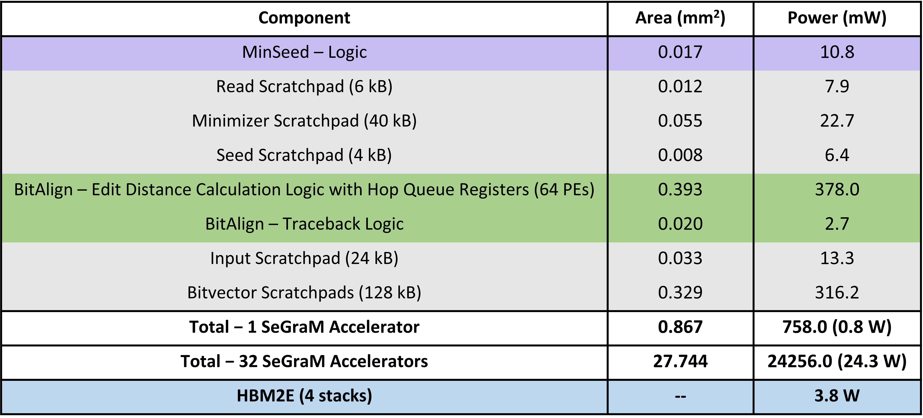
Key Results – Area & Power
Based on our synthesis of MinSeed and BitAlign accelerator datapaths using the Synopsys Design Compiler with a 28nm process (@ 1GHz):
Notes:
Based on our synthesis of MinSeed and BitAlign accelerator datapaths, [CLICK] total area overhead of SeGraM attached to all 32 channels is around 28mm2 and the total power consumption is around 28 W, including the HBM power.
[CLICK] We find that the main contributors for the area overhead and power consumption are (1) hopQueueRegisters since they constitute more than 60% of the area and power of BitAlign logic, and (2) the bitvector scratchpads.

Slide 29
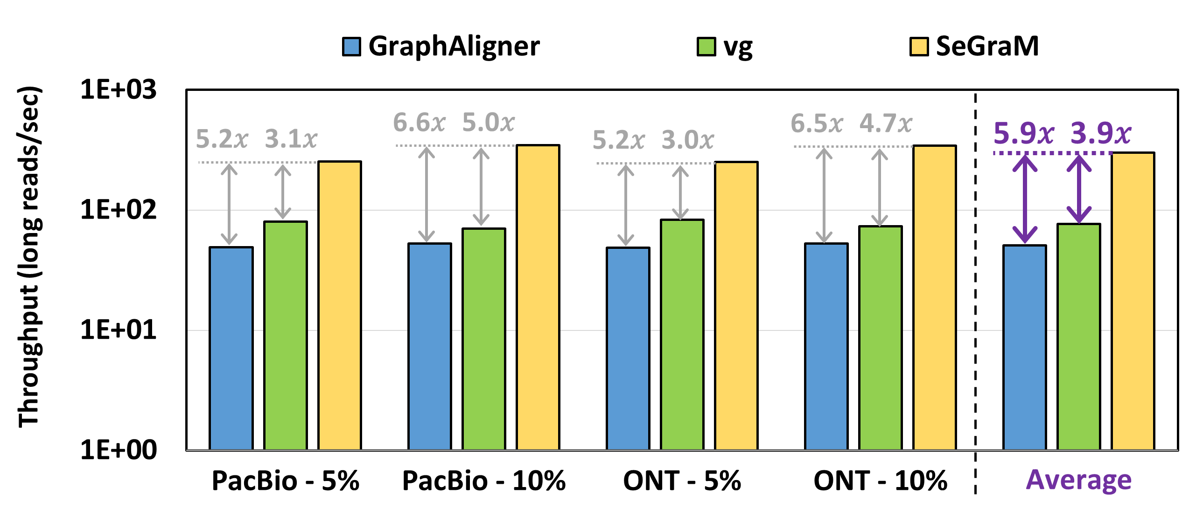
Key Results – SeGraM with Long Reads
SeGraM provides 5.9× and 3.9× throughput improvement over GraphAligner and vg,
while reducing the power consumption by 4.1× and 4.4×
Notes:
Let’s look at our long read analysis for s2g mapping with SeGraM. Here we only show our throughput numbers in the plot, not the power numbers.
Compared to two state-of-the-art s2g mapping software tools, GraphAligner and vg, we find that [CLICK]

Slide 30
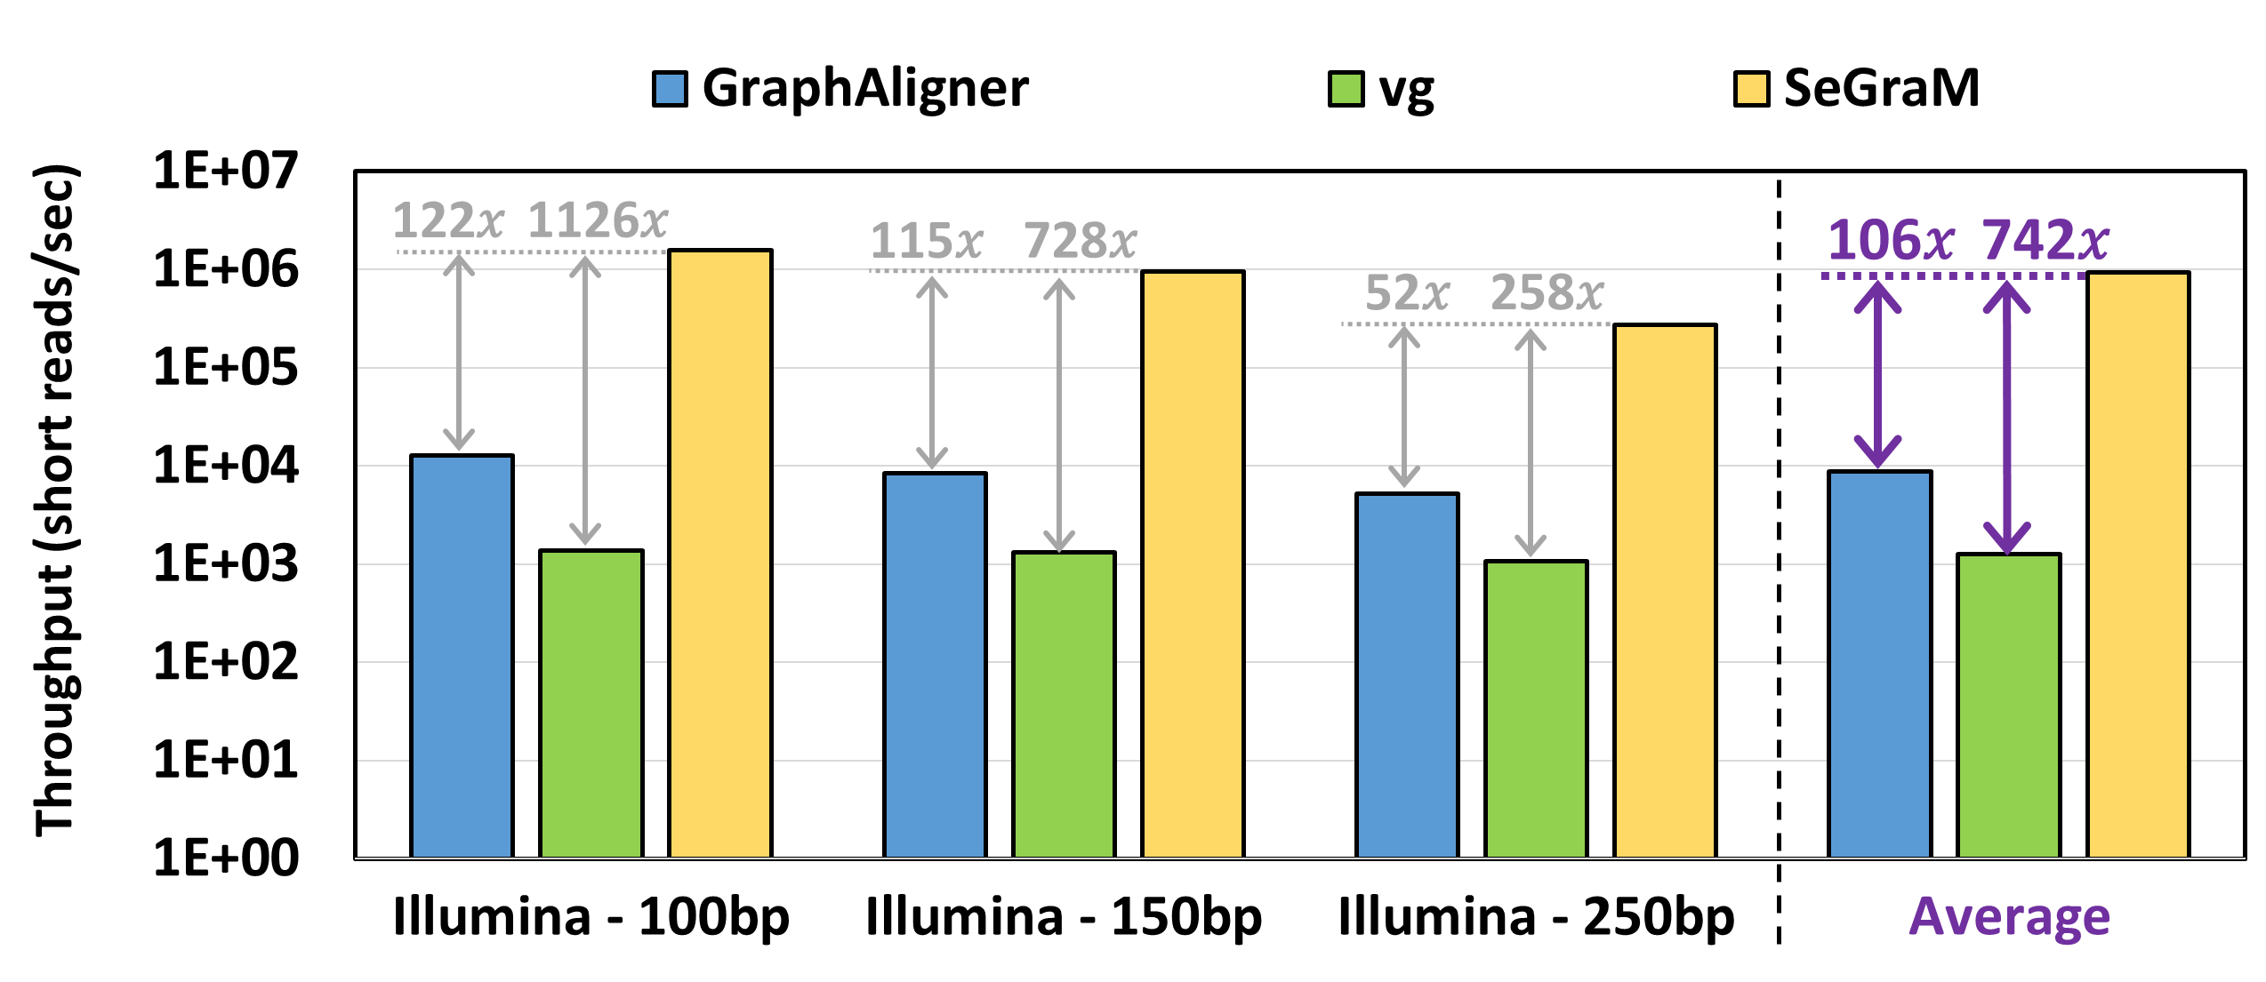
Key Results – SeGraM with Short Reads
SeGraM provides 106× and 742× throughput improvement over GraphAligner and vg,
while reducing the power consumption by 3.0× and 3.2×
Notes:
and when we look at our short read analysis, we find that [CLICK][CLICK]

Slide 31
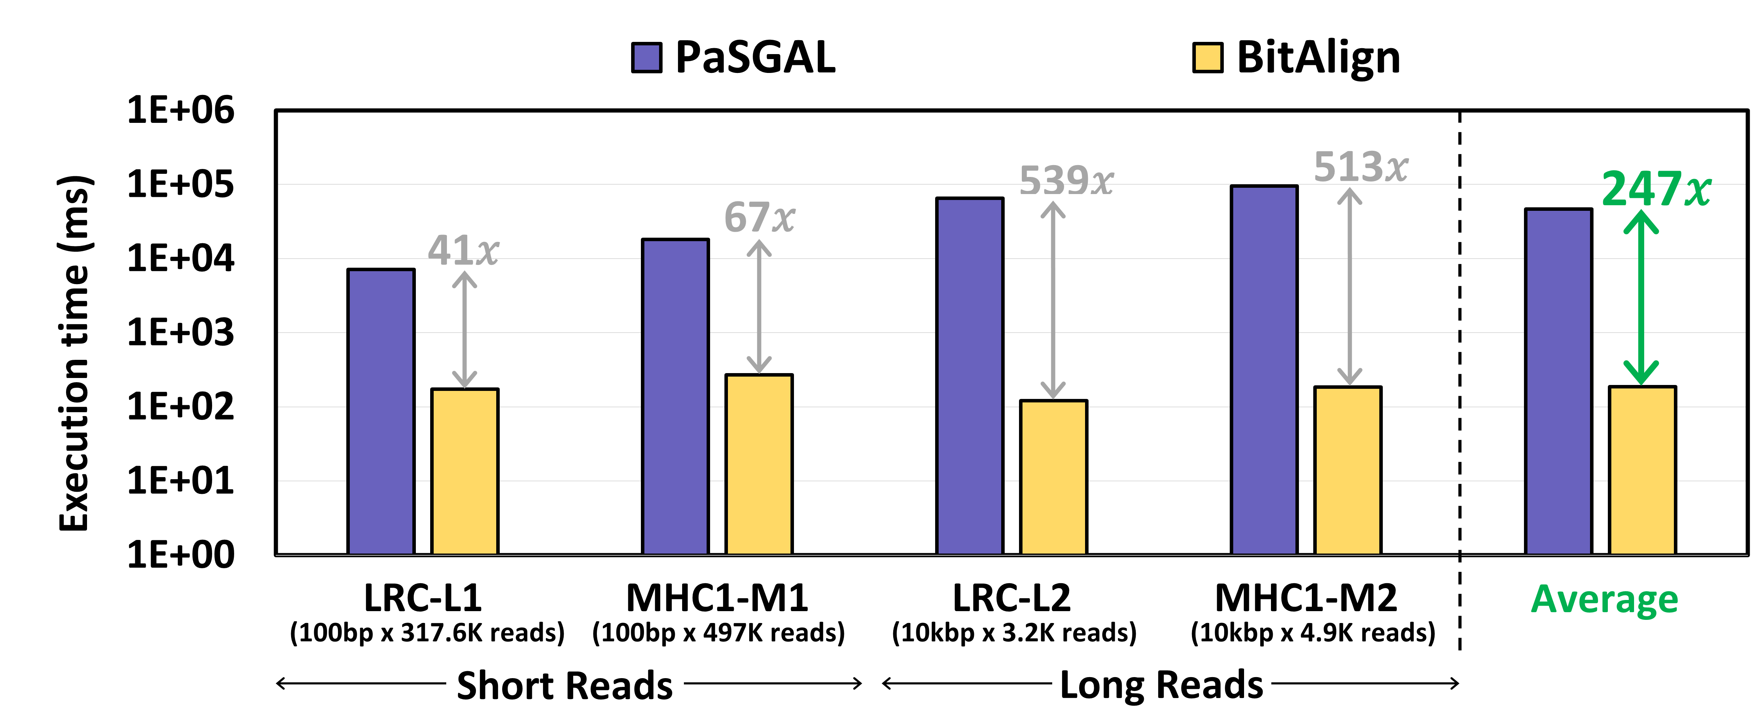
Key Results – BitAlign (S2G Alignment)
BitAlign provides 41×-539× speedup over PaSGAL
Notes:
Let’s look at the key results for the sequence-to-graph alignment module of SeGraM, which is BitAlign.

Slide 32
Key Results – BitAlign (S2S Alignment)
BitAlign can also be used for sequence-to-sequence alignment
The cost of more functionality: extra hop queue registers
We do not sacrifice any performance
For long reads (over GACT of Darwin and GenASM):
4.8× and 1.2× throughput improvement,
2.7× and 7.5× higher power consumption, and
1.5× and 2.6× higher area overhead
For short reads (over SillaX of GenAx and GenASM):
2.4× and 1.3× throughput improvement
Notes:
GACT of Darwin is optimized for long reads, SillaX of GenAx is optimized for short reads, and GenASM is optimized for both short and long reads.
We use the optimum configuration of each accelerator reported in their corresponding papers.

Slide 33
Outline
Introduction
Background
Genome Graphs
Sequence-to-Graph Mapping
SeGraM: Universal Genomic Mapping Accelerator
High-Level Overview
MinSeed
BitAlign
Use Cases
Evaluation
Conclusion
Notes:
Before I conclude,

Slide 34
Additional Details in the Paper
Details of the pre-processing steps of SeGraM
Details of the MinSeed and BitAlign algorithms
Details of the MinSeed and BitAlign hardware designs
Bottleneck analysis of the existing tools
Evaluation methodology details (datasets, baselines, performance model)
Additional results for the three evaluated use cases
Sources of improvements in SeGraM
Comparison of GenASM and SeGraM
Notes:
Here is the list of additional details that you can find in our paper. For example, sources of improvements in SeGraM

Slide 35
Conclusion
SeGraM: First universal algorithm/hardware co-designed genomic mapping accelerator that supports:
Sequence-to-graph (S2G) & sequence-to-sequence (S2S) mapping
Short & long reads
MinSeed: First minimizer-based seeding accelerator
BitAlign: First (bitvector-based) S2G alignment accelerator
SeGraM supports multiple use cases:
End-to-end S2G mapping
S2G alignment
S2S alignment
Seeding
SeGraM outperforms state-of-the-art software & hardware solutions
Notes:
[CLICK] To conclude, in this work, we propose SeGraM, the first universal… To our knowledge, SeGraM is also the first alg/hw co-design for accelerating S2G mapping.
[CLICK] SeGraM consists of 2 components: MinSeed … and BitAlign …
[CLICK] SeGraM supports multiple steps of S2G and S2S mapping pipelines, and
[CLICK] Based on our extensive analysis, we show that SeGraM outperforms state-of-the-art SW and HW solutions

Slide 36
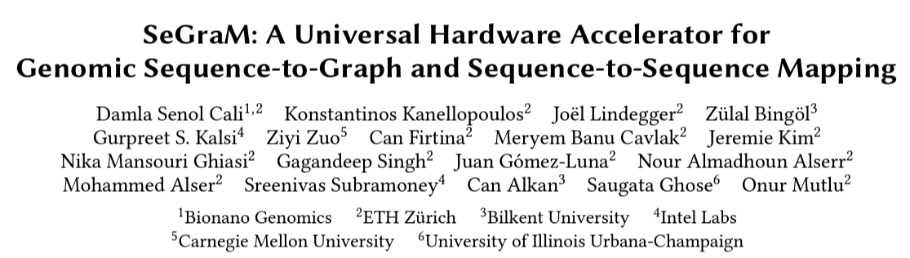
SeGraM [ISCA 2022]
Damla Senol Cali, Konstantinos Kanellopoulos, Joel Lindegger, Zulal Bingol, Gurpreet S. Kalsi, Ziyi Zuo, Can Firtina, Meryem Banu Cavlak, Jeremie S. Kim, Nika Mansouri Ghiasi, Gagandeep Singh, Juan Gomez-Luna, Nour Almadhoun Alserr, Mohammed Alser, Sreenivas Subramoney, Can Alkan, Saugata Ghose, and Onur Mutlu
“SeGraM: A Universal Hardware Accelerator for Genomic Sequence-to-Graph and Sequence-to-Sequence Mapping”
Proceedings of the 49th International Symposium on Computer Architecture (ISCA), New York City, NY, June 2022.
Notes:
Our paper is available online

Slide 37
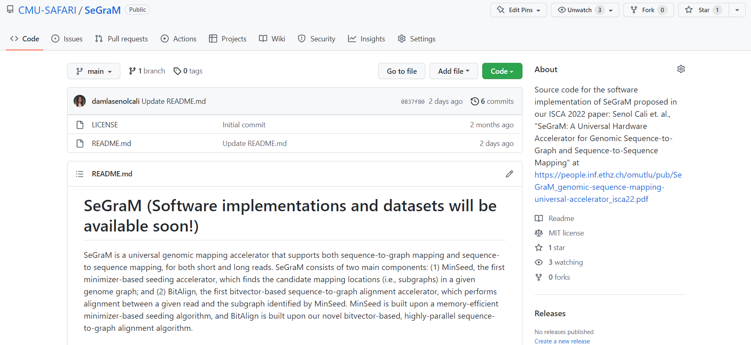
SeGraM – GitHub Page
https://github.com/CMU-SAFARI/SeGraM
Notes:
And we will be releasing our SW implementations and the datasets we use in our GitHub page soon.

Slide 38
SeGraM: A Universal Hardware Accelerator for Genomic Sequence-to-Graph and Sequence-to-Sequence Mapping
Damla Senol Cali, Ph.D.
damlasenolcali@gmail.com
https://damlasenolcali.github.io/
Konstantinos Kanellopoulos, Joel Lindegger, Zulal Bingol, Gurpreet S. Kalsi, Ziyi Zuo, Can Firtina, Meryem Banu Cavlak, Jeremie S. Kim, Nika Mansouri Ghiasi,
Gagandeep Singh, Juan Gomez-Luna, Nour Almadhoun Alserr, Mohammed Alser, Sreenivas Subramoney, Can Alkan, Saugata Ghose, Onur Mutlu
Notes:
Thank you so much!

Slide 39
Backup Slides (SeGraM)

Slide 40
Genome Sequence Analysis
Mapping the reads to a reference genome (i.e., read mapping) is a critical step in genome sequence analysis (GSA)
Sequence-to-Sequence (S2S) Mapping
Sequence-to-Graph (S2G) Mapping
Maps reads collected from an individual to a known linear reference genome sequence
Emphasizes the genetic variations that are present in the single reference genome
Ignores other variations that are not represented in the single linear reference sequence
Introduces reference bias
Replaces the linear reference sequence with a graph-based representation of the reference genome (genome graph)
Captures the genetic variations and diversity across many individuals in a population
Results in notable quality improvements in GSA
More difficult computational problem
No prior hardware design for graph-based GSA
Well studied with many available tools and accelerators
Notes:
[CLICK] A critical step of genome sequence analysis is the mapping of sequenced DNA fragments (i.e., reads) collected from an individual to a known linear reference genome sequence (i.e., sequence-to-sequence mapping).
[CLICK] Recent works replace the linear reference sequence with a graph-based representation of the reference genome, which captures the genetic variations and diversity across many individuals in a population.
[CLICK] Mapping reads to the graph-based reference genome (i.e., sequence-to-graph mapping) results in notable quality improvements in genome analysis. Unfortunately, while sequence-to-sequence mapping is well studied with many available tools and accelerators, sequence-to-graph mapping is a more difficult computational problem, with a much smaller number of practical software tools currently available.

Slide 41
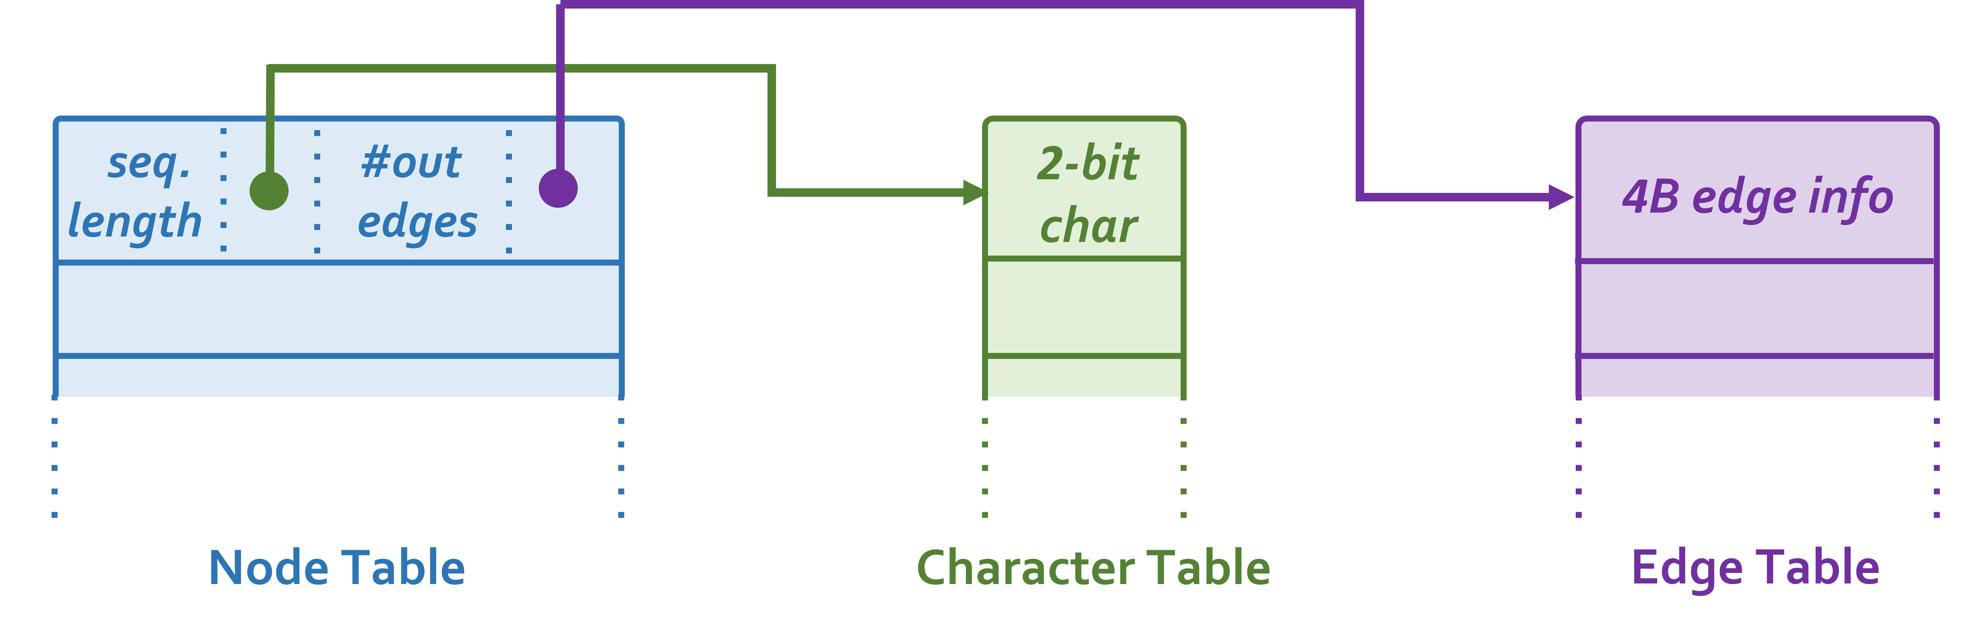
SeGraM – Graph Structure
Notes:
1.4 GB in total
620 MB nodes
740 MB chars
106 MB edges
We use the stats (i.e., number of nodes, number of edges and total sequence length) for each chromosome’s associated graph to determine the data sizes of our graph structure. Based on our analysis, we find that each node in the nodes table requires 32B per entry and the total size of the nodes table is #nodes * 32B. Since we can store characters in the sequences table using a 2-bit representation (since we only have 4 possible characters), the total size is total sequence length * 2bit. We also find that each entry in the edges table requires 4B, thus the total size of the edges table is #edges * 4B.
we use three separate table structures: (1) the nodes table, which stores the nodes of the graphs as the <node id> as the key and the <node’s sequence’s length, starting address at the sequences table, node’s number of outgoing edges, starting address at the edges table> as the value; (2) the sequences table, which stores the associated sequences of each node; and (3) the edges table, which stores the associated outgoing nodes (by node ID) of each node.

Slide 42
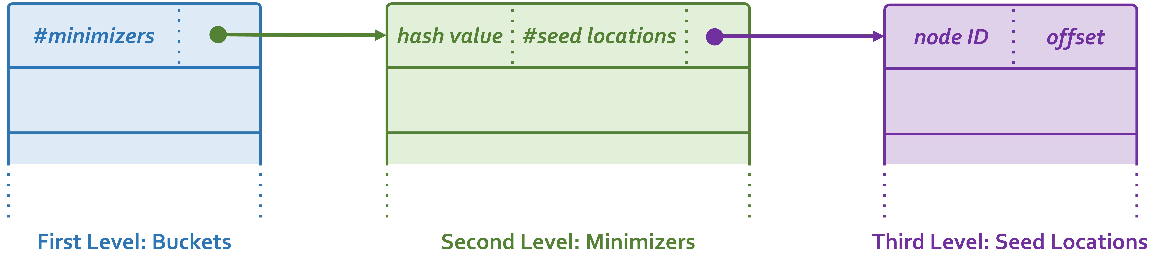
SeGraM – Index Structure
Notes:
9.8GB in total
In the first-level of the hash table, similar to Minimap2 [136], we have buckets to decrease the memory footprint of the index. Each entry in this first-level of the index stores <starting address of the minimizers in the corresponding bucket in the second-level, number of minimizers in the corresponding bucket>. In the second-level of the hash table, we have the minimizers. Each entry in this second-level of the index stores <hash value of the corresponding minimizer, starting address of the seed locations of the corresponding minimizer in the second-level, number of locations of the corresponding minimizer>. Minimizers are sorted based on their hash values in the second-level of the index. Finally, in the third-level of the hash table, we have the seed locations. Each entry in this third-level of the index stores <node ID of the corresponding seed location, relative offset of the corresponding seed location within the node>. Locations are grouped based on their corresponding minimizers and sorted within each group based on their values.
We use the stats (i.e., number of distinct minimizers, total number of locations, maximum number of minimizers per bucket, and maximum number of locations per minimizer) for each graph to determine the data sizes of our index structure. Based on our empirical analysis, we find that 224 is the optimum number of buckets in terms of memory footprint and the number of keys per each bucket. We also find that each bucket entry requires 4B of data, thus the total size of the first-level of the index is 224 * 4B. Each minimizer in the second-level of the index requires 12B of data, thus the total size of the second-level of the index is #distinct minimizers * 12B. Each location in the third-level of the index requires 8B of data, thus the total size of the third-level of the index is #total number of locations * 8B.

Slide 43
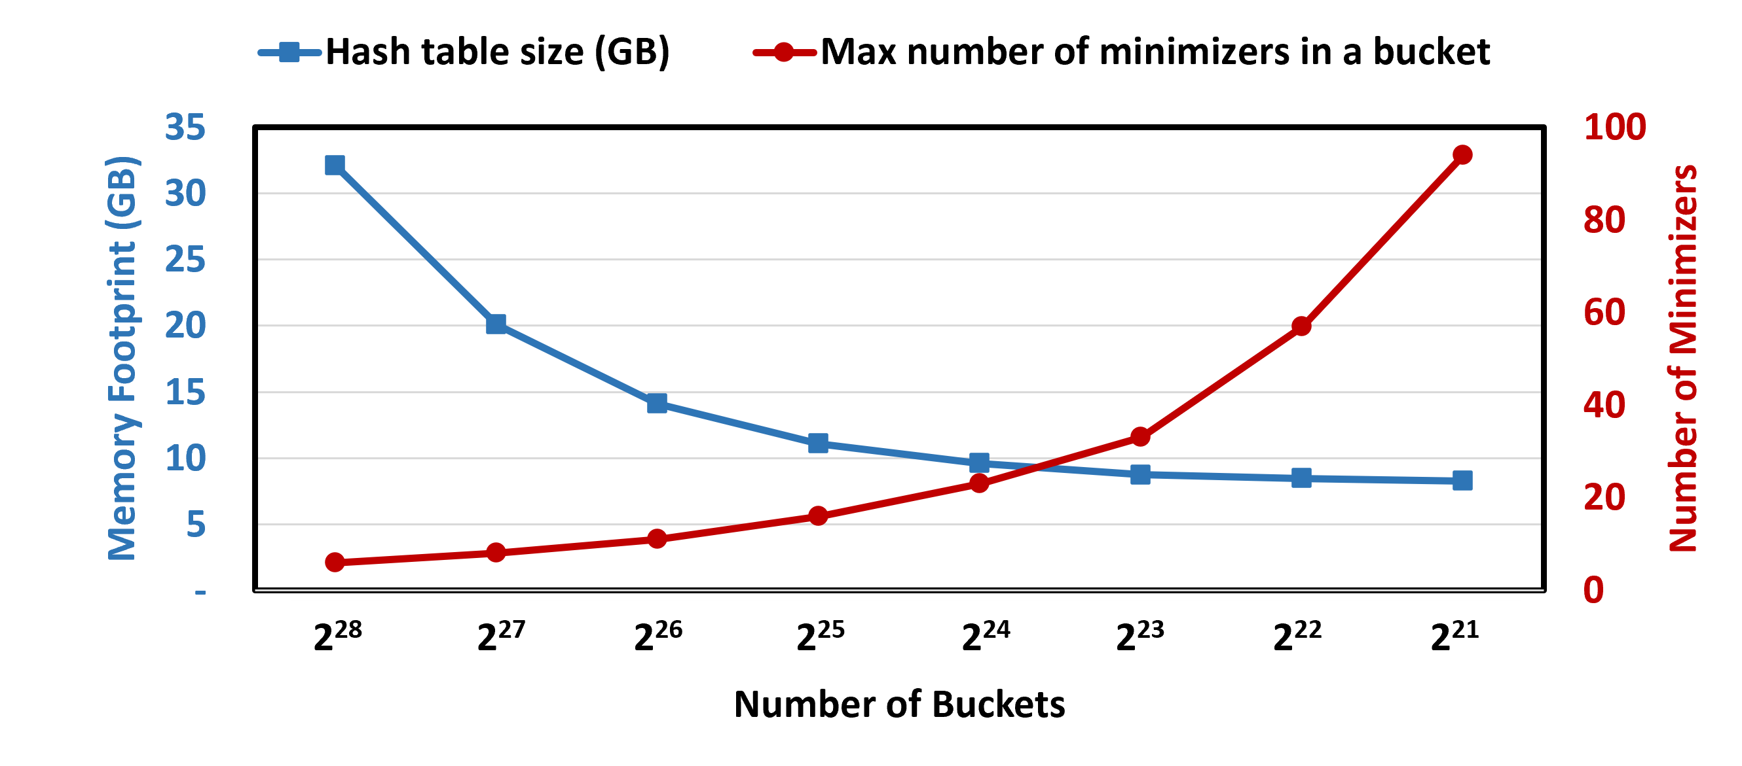
SeGraM – Selection of #Buckets

Slide 44
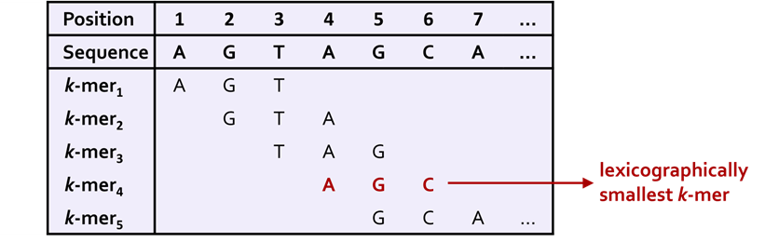
Minimizers
Notes:
***

Slide 45
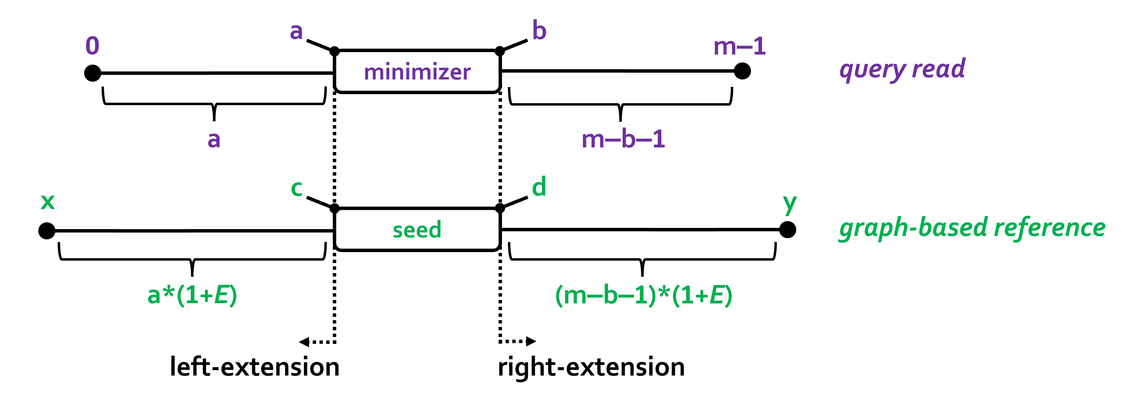
MinSeed – Region Calculation

Slide 46
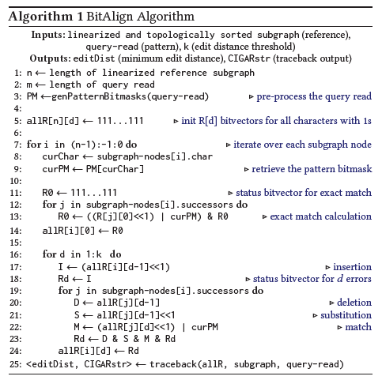
BitAlign Algorithm

Slide 47
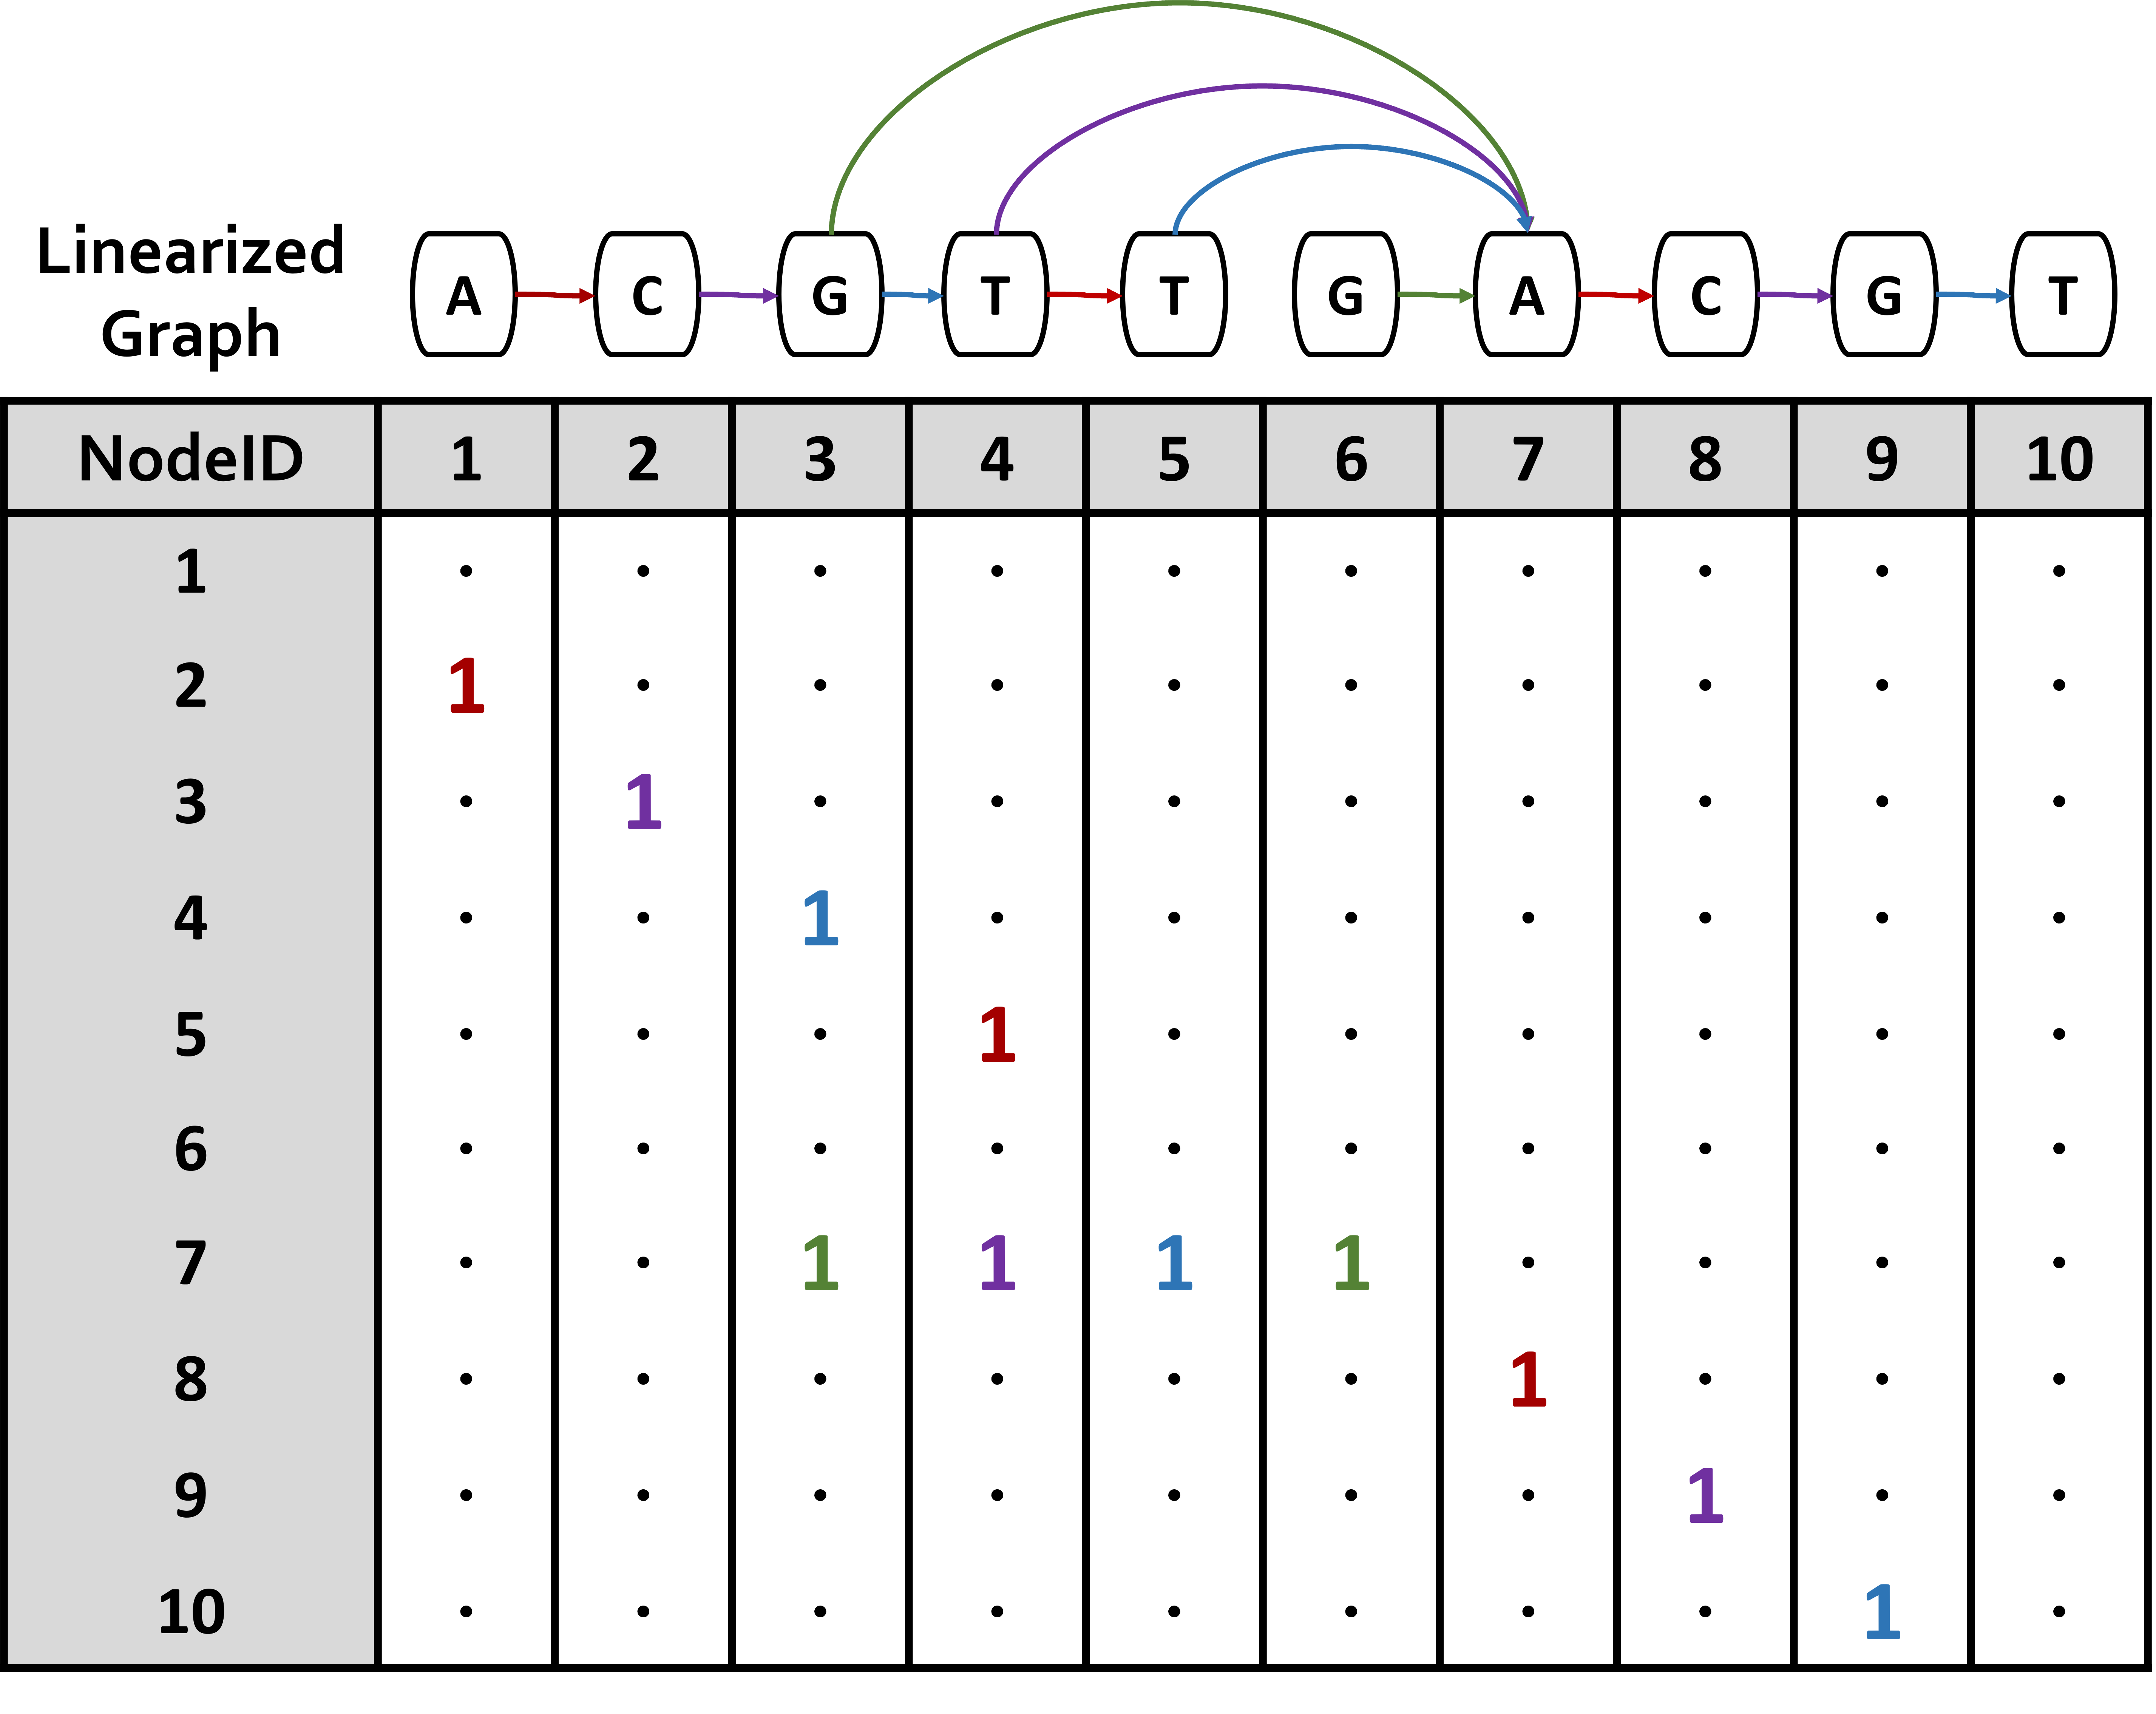
BitAlign – HopBits

Slide 48
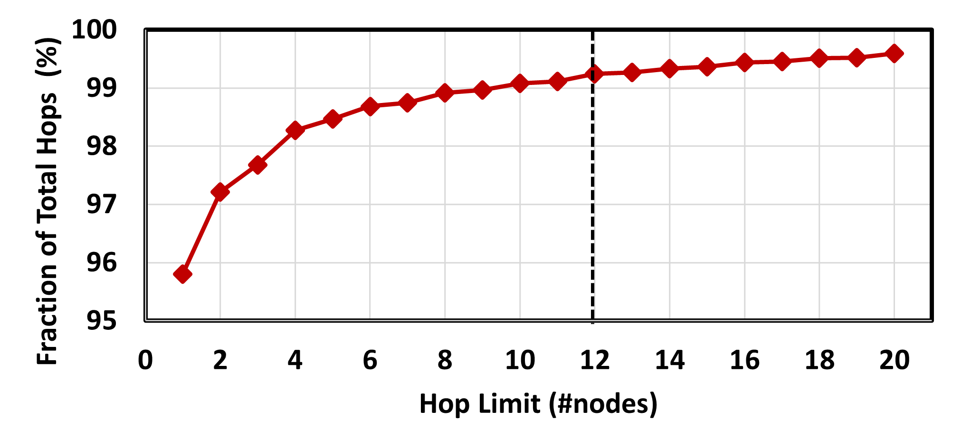
BitAlign – Hop Length Selection

Slide 49
Use Cases of SeGraM
(1) End-to-End Sequence-to-Graph Mapping
The whole SeGraM design (MinSeed + BitAlign) should be employed
We can use SeGraM to perform mapping with both short and long reads
(2) Sequence-to-Graph Alignment
BitAlign can be used as a standalone sequence-to-graph aligner without the need of an initial seeding tool/accelerator (e.g., MinSeed)
BitAlign is orthogonal to and can be coupled with any seeding (or filtering) tool/accelerator
(3) Sequence-to-Sequence Alignment
BitAlign can also be used for sequence-to-sequence alignment, as it is a special and simpler variant of sequence-to-graph alignment
(4) Seeding
MinSeed can be used as a standalone seeding accelerator for both graph-based mapping and traditional linear mapping
MinSeed is orthogonal to and can be coupled with any alignment tool/accelerator
Notes:
As a result of the flexibility and modularity of the SeGraM framework, we can run each accelerator (i.e., MinSeed and BitAlign) together for end-to-end mapping execution, or separately. Thus, we describe four use cases of SeGraM: (1) end-to-end mapping w/ SeGraM, (2) standalone s2g alignment, and (3), standalone s2s alignment w/ BitAlign, and (4) standalone seeding for both s2g and s2s w/ MinSeed.
=========================================================================================================
[CLICK] For sequence-to-graph mapping, the whole SeGraM design (MinSeed + BitAlign) should be employed, since both seeding and alignment steps are required. With the help of the divide-and-conquer approach inherited from the GenASM algorithm, we can use SeGraM to perform sequence-to-graph mapping for both short reads and long reads.
[CLICK] Since BitAlign takes in a graph-based reference and a query read as its inputs, it can be used as a standalone sequence-to-graph aligner, without MinSeed. BitAlign is orthogonal to and can be coupled with any seeding (or filtering) tool/accelerator.
[CLICK] BitAlign can also be used for sequence-to-sequence alignment, as sequence-to-sequence alignment is a special and simpler variant of sequence-to-graph alignment. [CLICK] Similarly, MinSeed can be used without BitAlign as a standalone seeding accelerator for both graph-based mapping and traditional linear mapping. MinSeed is orthogonal to and can be coupled with any alignment tool or accelerator.

Slide 50
Sources of Improvement
Co-design approach for both seeding and alignment:
Efficient and hardware-friendly algorithms for seeding and for alignment
Eliminating the data transfer bottleneck between the seeding and alignment steps of the genome sequence analysis pipeline, by placing their individual accelerators (MinSeed and BitAlign) adjacent to each other
Pipelining of the two accelerators within a SeGraM accelerator, which allows us to completely hide the latency of MinSeed
Overcoming the high cache miss rates observed from the baseline tools by carefully designing and sizing the on-chip scratchpads and the hop queue registers and matching the rate of computation for the logic units with memory bandwidth and memory capacity

Slide 51
Sources of Improvement (cont’d.)
Addressing the DRAM latency bottleneck by taking advantage of the natural channel subdivision exposed by HBM and eliminating any inter-accelerator interference-related latency in the memory system
Scaling linearly across three dimensions:
Within a single BitAlign accelerator, by incorporating processing elements (i.e., iteration-level parallelism),
Executing multiple seeds in parallel by using pipelined execution with the help of our double buffering approach (i.e., seed-level parallelism), and
Processing multiple reads concurrently without introducing inter-accelerator memory interference with the help of multiple HBM stacks that each contain the same content (i.e., read-level parallelism)

Slide 52
Backup Slides (GenASM)

Slide 53
Approximate String Matching
Sequenced genome may not exactly map to the reference genome due to genetic variations and sequencing errors
Approximate string matching (ASM):
Detect the differences and similarities between two sequences
In genomics, ASM is required to:
Find the minimum edit distance (i.e., total number of edits)
Find the optimal alignment with a traceback step
Sequence of matches, substitutions, insertions and deletions, along with their positions
Usually implemented as a dynamic programming (DP) based algorithm
Reference:
Read:
AAAATGTTTAGTGCTACTG
AAAATGTTTACTGCTACTTG
AAAATGTTTAGTGCTACTG
AAATGTTTACTGCTACTTG
AAAATGTTTAGTGCTACTTG
AAAATGTTTAGTGCTACTTG
AAAATGTTTAGTGCTACTG
AAAATGTTTAGTGCTACTTG
A
G
C
T
deletion
substitution
insertion
Notes:
As I introduced, read mapping is the first key step in genome sequence analysis.
[CLICK] When we are mapping the reads generated from the sequenced genome, they may not exactly map to the reference genome due to genetic variations and sequencing errors.
[CLICK] As we can see from this example, these errors and differences (which are also known as edits) can take the form of base [CLICK] deletions, [CLICK] substitutions and [CLICK] insertions.
[CLICK] Since multiple steps of read mapping must account for these errors, they must perform approximate string matching (ASM).
[CLICK] The goal of approximate string matching is to detect the differences and similarities between two sequences.
[CLICK] In genomics, ASM is required
[CLICK] (1) to determine the minimum number of edits between two genomic sequences (which is called edit distance), and also
[CLICK] (2) to find the optimal alignment with a traceback step., where we find the sequence of matches, substitutions, insertions and deletions, along with their positions.
[CLICK] Approximate string matching is typically implemented as a dynamic programming based algorithm, which has quadratic time and space complexity. Therefore, it is desirable to find lower-complexity algorithms for ASM.

Slide 54
Bitap Algorithm
Bitap^{1,2} performs ASM with fast and simple bitwise operations
Amenable to efficient hardware acceleration
Computes the minimum edit distance between a text (e.g., reference genome) and a pattern (e.g., read) with a maximum of k errors
Step 1: Pre-processing (per pattern)
Generate a pattern bitmask (PM) for each character in the alphabet (A, C, G, T)
Each PM indicates if character exists at each position of the pattern
Step 2: Searching (Edit Distance Calculation)
Compare all characters of the text with the pattern by using:
Pattern bitmasks
Status bitvectors that hold the partial matches
Bitwise operations
[1] R. A. Baeza-Yates and G. H. Gonnet. "A New Approach to Text Searching." CACM, 1992.
[2] S. Wu and U. Manber. "Fast Text Searching: Allowing Errors." CACM, 1992.
Notes:
[CLICK] One candidate to replace DP-based algorithms for ASM is the Bitap algorithm. Bitap uses only fast and simple bitwise operations to perform ASM, making it amenable to efficient hardware acceleration.
[CLICK] Bitap tackles the problem of computing the minimum edit distance between a reference text (e.g., reference genome) and a query pattern (e.g., read) with a maximum of k errors.
The algorithm has two steps. [CLICK]
Bitap starts with a pre-processing procedure
[CLICK] where we generate one pattern bitmask for each character in the alphabet. These pattern bitmasks help us to represent the query pattern in a binary format.
Second step (searching or edit distance calculation) is the main step of the algorithm. Here, [CLICK] we examine each text character one by one, by using
[CLICK] 1) the pre-processed pattern bitmasks,
[CLICK] 2) status bitvectors which are updated at each text iteration and hold the partial match information for the text characters examined so far, and
[CLICK] 3) the simple bitwise operations.

Slide 55
Bitap Algorithm (cont’d.)
Step 2: Edit Distance Calculation
For each character of the text (char):
Copy previous R bitvectors as oldR
R[0] = (oldR[0] << 1) | PM [char]
For d = 1…k:
deletion = oldR[d-1]
substitution = oldR[d-1] << 1
insertion = R[d-1] << 1
match = (oldR[d] << 1) | PM [char]
R[d] = deletion & mismatch & insertion & match
Check MSB of R[d]:
If 1, no match.
If 0, match with d many errors.
Large number of iterations
Notes:
I won’t get into the details of the algorithm, but let me highlight the three key properties of it.
First, Bitap iterates over each text character as the outer loop and it iterates over each possible edit distance (1 to k) as the inner loop.
Thus, when we have long error-prone reads, both of these loops need to iterate over very large numbers.

Slide 56
Bitap Algorithm (cont’d.)
Step 2: Edit Distance Calculation
For each character of the text (char):
Copy previous R bitvectors as oldR
R[0] = (oldR[0] << 1) | PM [char]
For d = 1…k:
deletion = oldR[d-1]
substitution = oldR[d-1] << 1
insertion = R[d-1] << 1
match = (oldR[d] << 1) | PM [char]
R[d] = deletion & mismatch & insertion & match
Check MSB of R[d]:
If 1, no match.
If 0, match with d many errors.
Data dependency between iterations (i.e., no parallelization)
Notes:
Second, There is two-level data dependency in Bitap.
[CLICK] There is an outer loop data dependency when computing deletion, substitution and match bitvectors as they require oldR bitvectors which are coming from previous text iteration.
[CLICK] Also, there is an inner loop data dependency when computing insertion bitvector as it requires R[d-1] which is coming from previous inner loop iteration.

Slide 57
Bitap Algorithm (cont’d.)
Step 2: Edit Distance Calculation
For each character of the text (char):
Copy previous R bitvectors as oldR
R[0] = (oldR[0] << 1) | PM [char]
For d = 1…k:
deletion = oldR[d-1]
substitution = oldR[d-1] << 1
insertion = R[d-1] << 1
match = (oldR[d] << 1) | PM [char]
R[d] = deletion & mismatch & insertion & match
Check MSB of R[d]:
If 1, no match.
If 0, match with d many errors.
Does not store and process these intermediate bitvectors to find the optimal alignment (i.e., no traceback)
Notes:
And third, Bitap generates these four intermediate bitvectors but they are not stored and processed with a traceback step to find the optimal alignment

Slide 58
Example for the Bitap Algorithm

Slide 59
Limitations of Bitap
Algorithm
Data Dependency Between Iterations:
Two-level data dependency forces the consecutive iterations to take place sequentially
No Support for Traceback:
Bitap does not include any support for optimal alignment identification
No Support for Long Reads:
Each bitvector has a length equal to the length of the pattern
Bitwise operations are performed on these bitvectors
Limited Compute Parallelism:
Text-level parallelism
Limited by the number of compute units in existing systems
Limited Memory Bandwidth:
High memory bandwidth required to read and write the computed bitvectors to memory
Hardware
Notes:
We find that Bitap has five limitations that hinder its applicability and efficient hardware acceleration for genome sequence analysis.
[CLICK] [CLICK] We have already covered the first two algorithmic limitations.
[CLICK] We find one more algorithmic limitation, which is no support for long reads. In Bitap, the query length so read length is limited by the word size of the machine running the algorithm because each bitvector has a length equal to the length of the pattern and we perform the bitwise operations on these bitvectors. Thus, the algorithm does not support long reads, whose lengths are on the order of thousands to millions of base pairs
[CLICK] These are the algorithmic limitations of the Bitap algorithm.
Even after we solve the algorithmic limitations of Bitap, we find that we cannot extract significant performance benefits with algorithmic enhancements alone.
[CLICK] 4) For example, while Bitap iterates over each character of the input text sequentially, we can enable text-level parallelism to improve its performance. However, the achievable level of parallelism is limited by the number of compute units in existing systems.
5) We would expect that a GPU, which has thousands of compute units, can overcome the limited compute parallelism issues that CPUs experience. [CLICK] However, we find that a GPU implementation of the Bitap algorithm suffers from the limited amount of memory bandwidth available for each GPU thread.
[CLICK] And these are the HW-related limitations.
In order to overcome these limitations and design an efficient accelerator, we find that we need to both (1) modify and extend the Bitap algorithm and (2) develop specialized hardware that can exploit the new opportunities that our algorithmic modifications provide.

Slide 60
GenASM: ASM Framework for GSA
Our Goal:
Accelerate approximate string matching
by designing a fast and flexible framework,
which can accelerate multiple steps of genome sequence analysis
GenASM: First ASM acceleration framework for GSA
Approximate string matching (ASM) acceleration framework based on the Bitap algorithm
We overcome the five limitations that hinder Bitap’s use in GSA:
Modified and extended ASM algorithm
Highly-parallel Bitap with long read support
Novel bitvector-based algorithm to perform traceback
Specialized, low-power and area-efficient hardware for both modified Bitap and novel traceback algorithms
SW
HW
Notes:
[CLICK] Our goal in this work is to design a fast and flexible framework for both short and long reads, which can accelerate multiple steps of genome sequence analysis (GSA).
[CLICK] To this end, we propose GenASM.
[CLICK] We base GenASM on Bitap, an ASM algorithm that uses only fast and simple bitwise operations, making it amenable to efficient hardware acceleration. To our knowledge, GenASM is the first work that enhances and accelerates Bitap.
[CLICK] We modify Bitap to support long reads and to enable parallelization.
We also develop a novel Bitap-compatible algorithm for traceback
[CLICK] And, we co-design specialized hardware for both algorithms.

Slide 61
GenASM Algorithm
GenASM-DC Algorithm:
Modified Bitap for Distance Calculation
Extended for efficient long read support
Besides bit-parallelism that Bitap has, extended for parallelism:
Loop unrolling
Text-level parallelism
GenASM-TB Algorithm:
Novel Bitap-compatible TraceBack algorithm
Walks through the intermediate bitvectors (match, deletion, substitution, insertion) generated by GenASM-DC
Follows a divide-and-conquer approach to decrease the memory footprint
Notes:
[CLICK] Our first algorithm GenASM-DC
[CLICK] is the modified Bitap algorithm for distance calculation, where
[CLICK] we extend it to provide efficient support for long reads, and
[CLICK] we enable parallelism besides bit-parallelism that baseline Bitap provides by
[CLICK] performing loop unrolling and removing the loop dependencies and
[CLICK] exploiting text-level parallelism, where we divide the text into overlapping sub-texts and search the query in each of these sub-texts in parallel.
[CLICK] Our second algorithm, GenASM-TB, is a novel Bitap-compatible traceback algorithm,.
[CLICK] which walks through the intermediate bitvectors (match, deletion, substitution, insertion) generated by GenASM-DC and finds the optimal alignment.
[CLICK] In order to decrease the memory footprint of the algorithm, it follows a divide-and-conquer approach, where we divide the text and pattern into overlapping windows and perform the traceback computation for each window. After all of the windows’ partial traceback outputs are generated, we merge them to find the complete traceback output.

Slide 62
Loop Unrolling in GenASM-DC

Slide 63
Traceback Example with GenASM-TB

Slide 64
GenASM Hardware Design
Main Memory
GenASM-DC
GenASM-DC
GenASM-TB
GenASM-DC
Accelerator
GenASM-TB
GenASM-DC
Accelerator
DC-SRAM
DC-SRAM
TB-SRAM₁
TB-SRAM₁
GenASM-TB
Accelerator
GenASM-TB
Accelerator
TB-SRAM₂
Host CPU
TB-SRAM₂
.
.
.
TB-SRAM_{n}
TB-SRAM_{n}
GenASM-DC:
generates bitvectors
and performs edit
Distance Calculation
GenASM-TB: performs TraceBack and assembles the optimal alignment
Notes:
Let’s look at the HW design of GenASM.
Our co-designed hardware consists of two components:
[CLICK] (1) GenASM-DC, which provides hardware support to efficiently execute our GenASM-DC algorithm to perform distance calculation; and
[CLICK] (2) GenASM-TB, which provides hardware support to efficiently execute our novel GenASM-TB algorithm to find the optimal alignment.
GenASM also has two types of SRAM buffers: [CLICK] DC-SRAM and [CLICK] TB-SRAMs
Let’s look at the high-level overview of GenASM

Slide 65
GenASM Hardware Design
Main Memory
GenASM-DC
GenASM-DC
GenASM-TB
GenASM-DC
Accelerator
GenASM-TB
GenASM-DC
Accelerator
DC-SRAM
DC-SRAM
2
2
reference text
& query pattern
7
reference text
& query pattern
sub-text &
sub-pattern
Find the
traceback output
3
sub-text &
sub-pattern
3
TB-SRAM₁
TB-SRAM₁
GenASM-TB
Accelerator
GenASM-TB
Accelerator
6
5
6
5
TB-SRAM₂
Host CPU
TB-SRAM₂
Write
bitvectors
Write
bitvectors
Read
bitvectors
.
.
.
Read
bitvectors
1
1
TB-SRAM_{n}
reference & query locations
TB-SRAM_{n}
reference & query locations
Generate
bitvectors
Generate
bitvectors
4
4
GenASM-DC:
generates bitvectors
and performs edit
Distance Calculation
GenASM-TB: performs TraceBack and assembles the optimal alignment
Notes:
[CLICK] GenASM execution starts when the host CPU issues a task to GenASM with the reference and the query sequences’ locations.
[CLICK] GenASM-DC reads the corresponding reference text region and the query pattern from the memory, and then writes these to its dedicated SRAM, DC-SRAM.
[CLICK] After that, GenASM-DC divides the reference text and query pattern into multiple overlapping windows, and
[CLICK] for each sub-text and sub-pattern, GenASM-DC searches for the sub-pattern within the sub-text and generates the bitvectors.
[CLICK] GenASM-DC writes the generated bitvectors to TB-SRAMs. Once GenASM-DC completes its search for the current window,
[CLICK] GenASM-TB starts reading the stored bitvectors from TB-SRAMs and
[CLICK] generates the window’s traceback output.
Once GenASM-TB generates this output, GenASM computes the next window and repeats Steps 3–7 until all windows are completed.

Slide 66
GenASM Hardware Design
Main Memory
GenASM-DC
GenASM-DC
GenASM-TB
GenASM-DC
Accelerator
GenASM-TB
GenASM-DC
Accelerator
DC-SRAM
DC-SRAM
2
reference text
& query pattern
7
sub-text &
sub-pattern
Find the
traceback output
3
TB-SRAM₁
TB-SRAM₁
GenASM-TB
Accelerator
GenASM-TB
Accelerator
5
TB-SRAM₂
6
Host CPU
TB-SRAM₂
Write
bitvectors
.
.
.
Read
bitvectors
1
TB-SRAM_{n}
reference & query locations
TB-SRAM_{n}
Generate
bitvectors
4
GenASM-DC:
generates bitvectors
and performs edit
Distance Calculation
GenASM-TB: performs TraceBack and assembles the optimal alignment
Our specialized compute units and on-chip SRAMs help us to:
Match the rate of computation with memory capacity and bandwidth
Achieve high performance and power efficiency
Scale linearly in performance with the number of parallel compute units that we add to the system
Notes:
[CLICK] Our specialized compute units and on-chip SRAMs helps us to:
[CLICK] (1) Match the rate of computation with memory capacity and bandwidth
[CLICK] (2) Achieve high performance and power efficiency
[CLICK] (3) Scale linearly in performance with the number of parallel compute units that we add to the system

Slide 67
GenASM-DC: Hardware Design
Linear cyclic systolic array based accelerator
Designed to maximize parallelism and minimize memory bandwidth and memory footprint
Processing Block (PB)
Processing Core (PC)
Notes:
Let's look at GenASM-DC's hardware design.
[CLICK] We implement GenASM-DC as a linear cyclic systolic array based accelerator, using small and very simple logic components.
[CLICK] This design helps us to maximize parallelism and minimize memory BW and footprint.
[CLICK] Processing Core is the basic compute component which computes the intermediate bitvectors
[CLICK] and when we add the flip-flop-based storage logic around Processing Core, we define a Processing Element (PE)
[CLICK] Multiple PEs are concatenated to define a Processing Block
[CLICK] We also have DC-SRAM, which stores the reference text, the pattern bitmasks for the query read, and the intermediate data generated from PEs, and we also have
[CLICK] TB-SRAMs, which store the intermediate bitvectors generated by each PE of GenASM-DC for later use by GenASM-TB.

Slide 68
GenASM-TB: Hardware Design
1
1
Last CIGAR
1
2
.
.
64
Last CIGAR
1
2
.
.
64
64
64
match
match
2
2
CIGAR string
CIGAR string
Bitwise Comparisons
64
Bitwise Comparisons
64
insertion
insertion
CIGAR
out
192
CIGAR
out
192
deletion
64
deletion
64
3
3
Next Rd Addr Compute
subs
Next Rd Addr Compute
64
subs
64
<<
<<
1.5KB
TB-SRAM₁
1.5KB
TB-SRAM₂
GenASM-TB
1.5KB
TB-SRAM₆₄
to main
memory
Very simple logic:
❶Reads the bitvectors from one of the TB-SRAMs using the computed address
❷Performs the required bitwise comparisons to find the traceback output for the current position
❸Computes the next TB-SRAM address to read the new set of bitvectors
1
2
3
Notes:
[CLICK] We implement GenASM-TB hardware using very simple logic, which
[CLICK] 1) reads the bitvectors from one of the TB-SRAMs using the computed address,
[CLICK] 2) performs the required bitwise comparisons to find the traceback output for the current position, and
[CLICK] 3) computes the next TB-SRAM address to read the new set of bitvectors.
After GenASM-TB finds the complete traceback output (which is also called CIGAR string), [CLICK] it writes the output to main memory and completes its execution.

Slide 69
Use Cases of GenASM
Read Alignment Step of Read Mapping
Find the optimal alignment of how reads map to candidate reference regions
Pre-Alignment Filtering for Short Reads
Quickly identify and filter out the unlikely candidate reference regions for each read
Edit Distance Calculation
Measure the similarity or distance between two sequences
We also discuss other possible use cases of GenASM in our paper:
Read-to-read overlap finding, hash-table based indexing, whole genome alignment, generic text search
Notes:
We demonstrate the efficiency and flexibility of the GenASM acceleration framework by describing three use cases of approximate string matching in genome sequence analysis:
[CLICK] (1) read alignment step of short and long read mapping,
Which is the most time consuming step of read mapping that we align each read to all of its candidate reference regions and then find the optimal alignment.
[CLICK] (2) pre-alignment filtering for short reads,
Where we aim to quickly identify and filter out the unlikely candidate reference regions of each read by approximating the edit distance between them and filter out if it is above a threshold.
[CLICK] (3) edit distance calculation between any two arbitrary-length sequences.
Which is one of the fundamental operations in genomics that measures the similarity or distance btw two sequences
[CLICK] We believe the GenASM framework can be useful for many other use cases, and we discuss some of them briefly in our paper.

Slide 70
Evaluation Methodology
We evaluate GenASM using:
Synthesized SystemVerilog models of the GenASM-DC and GenASM-TB accelerator datapaths
Detailed simulation-based performance modeling
16GB HMC-like 3D-stacked DRAM architecture
32 vaults
256GB/s of internal bandwidth, clock frequency of 1.25GHz
In order to achieve high parallelism and low power-consumption
Within each vault, the logic layer contains a GenASM-DC accelerator, its associated DC-SRAM, a GenASM-TB accelerator, and TB-SRAMs.
Notes:
[CLICK] We evaluate GenASM using a combination of
(1) synthesis of our DC and TB accelerator datapaths, and
(2) detailed simulation-based performance modeling
[CLICK] We evaluate a 16GB HMC-like 3D-stacked DRAM arch, with 32 vaults. Our accelerators can be ported anywhere in the system, but in order to achieve high parallelism and low power-consumption, we place GenASM-DC and GenASM-TB in the logic layer of 3D-stacked memory. As I will show next, our hardware is highly efficient in terms of both area and power, so they are within the budget limits of the logic layer.

Slide 71
Evaluation Methodology (cont’d.)
 | SW Baselines | HW Baselines
Read Alignment | Minimap2¹ BWA-MEM² | GACT (Darwin)³ SillaX (GenAx)⁴
Pre-Alignment Filtering | – | Shouji⁵
Edit Distance Calculation | Edlib⁶ | ASAP⁷
[1] H. Li. "Minimap2: Pairwise Alignment for Nucleotide Sequences." In Bioinformatics, 2018.
[2] H. Li. "Aligning sequence reads, clone sequences and assembly contigs with BWA-MEM." In arXiv, 2013.
[3] Y. Turakhia et al. "Darwin: A genomics co-processor provides up to 15,000 x acceleration on long read assembly." In ASPLOS, 2018.
[4] D. Fujiki et al. "GenAx: A genome sequencing accelerator." In ISCA, 2018.
[5] M. Alser. "Shouji: A fast and efficient pre-alignment filter for sequence alignment." In Bioinformatics, 2019.
[6] M. Šošić et al. "Edlib: A C/C++ library for fast, exact sequence alignment using edit distance." In Bioinformatics, 2017.
[7] S.S. Banerjee et al. ”ASAP: Accelerated short-read alignment on programmable hardware." In TC, 2018.
Notes:
[CLICK] For the use cases we evaluate, we compare GenASM with state-of-the-art HW and SW baselines.

Slide 72
Evaluation Methodology (cont’d.)
For Use Case 1: Read Alignment, we compare GenASM with:
Minimap2 and BWA-MEM (state-of-the-art SW)
Running on Intel® Xeon® Gold 6126 CPU (12-core) operating @2.60GHz with 64GB DDR4 memory
Using two simulated datasets:
Long ONT and PacBio reads: 10Kbp reads, 10-15% error rate
Short Illumina reads: 100-250bp reads, 5% error rate
GACT of Darwin and SillaX of GenAx (state-of-the-art HW)
Open-source RTL for GACT
Data reported by the original work for SillaX
GACT is best for long reads, SillaX is best for short reads
Notes:
I won’t go into details, so you can refer to our paper for more details.

Slide 73
Evaluation Methodology (cont’d.)
For Use Case 2: Pre-Alignment Filtering, we compare GenASM with:
Shouji (state-of-the-art HW – FPGA-based filter)
Using two datasets provided as test cases:
100bp reference-read pairs with an edit distance threshold of 5
250bp reference-read pairs with an edit distance threshold of 15
For Use Case 3: Edit Distance Calculation, we compare GenASM with:
Edlib (state-of-the-art SW)
Using two 100Kbp and 1Mbp sequences with similarity ranging between 60%-99%
ASAP (state-of-the-art HW – FPGA-based accelerator)
Using data reported by the original work

Slide 74
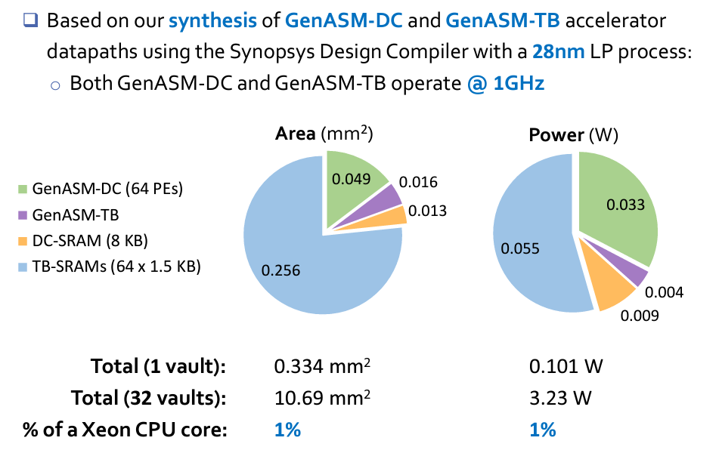
Key Results – Area and Power
Based on our synthesis of GenASM-DC and GenASM-TB accelerator datapaths using the Synopsys Design Compiler with a 28nm process:
Both GenASM-DC and GenASM-TB operate @ 1GHz
Notes:
[CLICK] We synthesize our DC and TB accelerator datapaths with a typical 28nm process:
[CLICK] Both accelerators operates at 1GHz.
[CLICK] We find that for 32 GenASM accelerator (one for each HMC vault), total area overhead is ten point sixty nine millimeter square and total power consumption is three point twenty-three watts.
We observe that both area and power consumption of GenASM (at 1 vault) is around 1% of the area and power consumption of a single Xeon CPU core.

Slide 75
Key Results – Area and Power
Based on our synthesis of GenASM-DC and GenASM-TB accelerator datapaths using the Synopsys Design Compiler with a 28nm process:
Both GenASM-DC and GenASM-TB operate @ 1GHz
GenASM has low area and power overheads
Notes:
Thus, GenASM has low area and power overheads.

Slide 76
Key Results – Use Case 1
Read Alignment Step of Read Mapping
Find the optimal alignment of how reads map to candidate reference regions
Pre-Alignment Filtering for Short Reads
Quickly identify and filter out the unlikely candidate reference regions for each read
Edit Distance Calculation
Measure the similarity or distance between two sequences
Notes:
Let’s look at our results for the first use case: read alignment

Slide 77
Key Results – Use Case 1 (Long Reads)
116×
648×
GenASM achieves 648× and 116× speedup over
12-thread runs of BWA-MEM and Minimap2,
while reducing power consumption by 34× and 37×
SW
Notes:
[CLICK] As software baselines, we compare GenASM with BWA-MEM (which is shown with red bars) and Minimap2 (which is shown with purple bars). Both are commonly used, state-of-the-art read mappers.
[CLICK] We find that GenASM achieves [CLICK] six hundred and forty eight times speedup over 12-thread run of BWA-MEM and [CLICK] a hundred and sixteen times speedup over 12-thread run of Minimap2 (SW), [CLICK] while reducing power consumption by thirty four times and thirty seven times.

Slide 78
Key Results – Use Case 1 (Long Reads)
3.9×
HW
GenASM provides 3.9× better throughput,
6.6× the throughput per unit area, and
10.5× the throughput per unit power,
compared to GACT of Darwin
Notes:
[CLICK] Compared to GACT of Darwin, which is a state-of-the-art long read alignment accelerator, [CLICK] GenASM provides 3.9 times better throughput, [CLICK] 6.6 times better throughput per unit area, and 10.5 times better throughput per unit power.

Slide 79
Key Results – Use Case 1 (Short Reads)
158×
111×
SW
GenASM achieves 111× and 158× speedup over
12-thread runs of BWA-MEM and Minimap2,
while reducing power consumption by 33× and 31×
GenASM provides 1.9× better throughput and
uses 63% less logic area and 82% less logic power,
compared to SillaX of GenAx
HW
Notes:
[CLICK] For short reads, compared to same SW baselines, [CLICK] [CLICK] [CLICK] GenASM provides significant speedup and reduction in power consumption, similar to long reads.
[CLICK] Compared to SillaX of GenAx, which is a state-of-the-art short read alignment accelerator, GenASM provides 1.9 times better throughput, while using 63% less logic area and 82% less logic power.

Slide 80
Key Results – Use Case 2
Read Alignment Step of Read Mapping
Find the optimal alignment of how reads map to candidate reference regions
Pre-Alignment Filtering for Short Reads
Quickly identify and filter out the unlikely candidate reference regions for each read
Edit Distance Calculation
Measure the similarity or distance between two sequences
Notes:
Let’s look at our results for the second use case: pre-alignment filtering

Slide 81
Key Results – Use Case 2
Compared to Shouji:
3.7× speedup
1.7× less power consumption
False accept rate of 0.02% for GenASM vs. 4% for Shouji
False reject rate of 0% for both GenASM and Shouji
GenASM is more efficient in terms of
both speed and power consumption,
while significantly improving the accuracy
of pre-alignment filtering
HW
Notes:
[CLICK] I do not have time to cover this result in detail, but here is the key takeaway:
Compared to Shouji, which is a state-of-the-art FPGA-based filter, GenASM is more efficient in terms of both speed and power consumption, while significantly improving the accuracy of pre-alignment filtering

Slide 82
Key Results – Use Case 3
Read Alignment Step of Read Mapping
Find the optimal alignment of how reads map to candidate reference regions
Pre-Alignment Filtering for Short Reads
Quickly identify and filter out the unlikely candidate reference regions for each read
Edit Distance Calculation
Measure the similarity or distance between two sequences
Notes:
Let’s look at our results for the third use case: edit distance calculation

Slide 83
Key Results – Use Case 3
12501×
627×
146×
1458×
GenASM provides 146 – 1458× and 627 – 12501× speedup,
while reducing power consumption by 548× and 582×
for 100Kbp and 1Mbp sequences, respectively, compared to Edlib
SW
GenASM provides 9.3 – 400× speedup over ASAP,
while consuming 67× less power
HW
Notes:
Again, I won’t be able to cover these results in detail, but here are the key takeaways:
Compared to the SW baseline, Edlib, GenASM provides 2 to 4 orders of magnitude speedup, while reducing power consumption by 2 orders of magnitude.
And compared to the HW baseline, ASAP, GenASM provides 9.3 to 400 times speedup, while consuming 67 times less power

Slide 84
Key Results – Summary
Read Alignment
116× speedup, 37× less power than Minimap2 (state-of-the-art SW)
111× speedup, 33× less power than BWA-MEM (state-of-the-art SW)
3.9× better throughput, 2.7× less power than Darwin (state-of-the-art HW)
1.9× better throughput, 82% less logic power than GenAx (state-of-the-art HW)
Pre-Alignment Filtering
3.7× speedup, 1.7× less power than Shouji (state-of-the-art HW)
Edit Distance Calculation
22–12501× speedup, 548–582× less power than Edlib (state-of-the-art SW)
9.3–400× speedup, 67× less power than ASAP (state-of-the-art HW)
Notes:
GenASM is flexible and can be used to accelerate multiple use cases.
In this work, we evaluate three use cases in detail: [CLICK] read alignment, [CLICK] pre-alignment filtering and [CLICK] edit distance calculation.
We find that, for all the three use cases [CLICK] [CLICK] [CLICK], GenASM is significantly more efficient in terms of both speed and power consumption than state-of-the-art software and hardware baselines

Slide 85
Additional Details in the Paper
Details of the GenASM-DC and GenASM-TB algorithms
Big-O analysis of the algorithms
Detailed explanation of evaluated use cases
Evaluation methodology details (datasets, baselines, performance model)
Additional results for the three evaluated use cases
Sources of improvements in GenASM (algorithm-level, hardware-level, technology-level)
Discussion of four other potential use cases of GenASM
Notes:
Here is the list of additional details that you can find in our paper.

Slide 86
Summary of GenASM
Problem:
Genome sequence analysis is bottlenecked by the computational power and memory bandwidth limitations of existing systems
This bottleneck is particularly an issue for approximate string matching
Key Contributions:
GenASM: An approximate string matching (ASM) acceleration framework to accelerate multiple steps of genome sequence analysis
First to enhance and accelerate Bitap for ASM with genomic sequences
Co-design of our modified scalable and memory-efficient algorithms with low-power and area-efficient hardware accelerators
Evaluation of three different use cases: read alignment, pre-alignment filtering, edit distance calculation
Key Results: GenASM is significantly more efficient for all the three use cases (in terms of throughput and throughput per unit power) than state-of-the-art software and hardware baselines
Notes:
[CLICK] To conclude, in this work, we focus on approximate string matching because it is one of the main bottlenecks of genome sequence analysis.
[CLICK] We propose GenASM, an approximate string matching (ASM) acceleration framework to accelerate multiple steps of genome sequence analysis
[CLICK] GenASM is the first work that enhances and accelerates Bitap for ASM with genomic sequences
[CLICK] In GenASM, we co-design our modified scalable and memory-efficient algorithms with low-power and area-efficient hardware accelerators
[CLICK] We evaluate three different use cases and
[CLICK] we show that GenASM is significantly more efficient for all the three use cases (in terms of throughput and throughput per unit power) than state-of-the-art software and hardware baselines

Slide 87
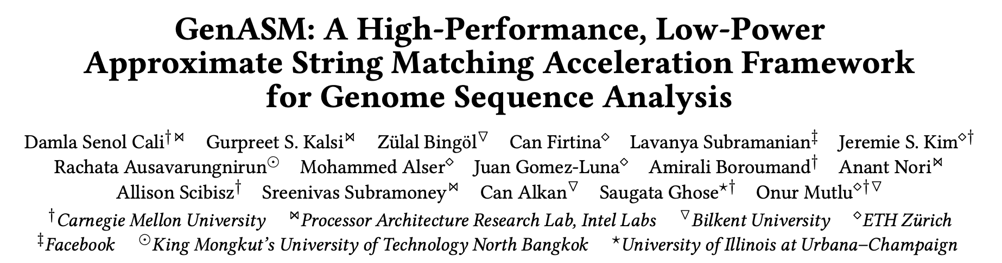
GenASM [MICRO 2020]
Damla Senol Cali, Gurpreet S. Kalsi, Zulal Bingol, Can Firtina, Lavanya Subramanian, Jeremie S. Kim, Rachata Ausavarungnirun, Mohammed Alser, Juan Gomez-Luna, Amirali Boroumand, Anant Nori, Allison Scibisz, Sreenivas Subramoney, Can Alkan, Saugata Ghose, and Onur Mutlu,
"GenASM: A High-Performance, Low-Power Approximate String Matching Acceleration Framework for Genome Sequence Analysis”
Proceedings of the 53rd International Symposium on Microarchitecture (MICRO), Virtual, October 2020.
Notes:
You can refer to our paper for more details.

Slide 88
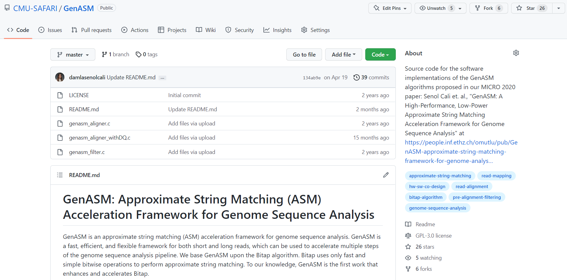
GenASM – GitHub Page
https://github.com/CMU-SAFARI/GenASM

Slide 89
Backup Slides (Sequencing)

Slide 90





Genome Sequencing
Chopped DNA
fragments
Sequenced reads
Sample Collection
Sequencing
Large DNA
molecule
Preparation
Genome Sequence Analysis

Slide 91
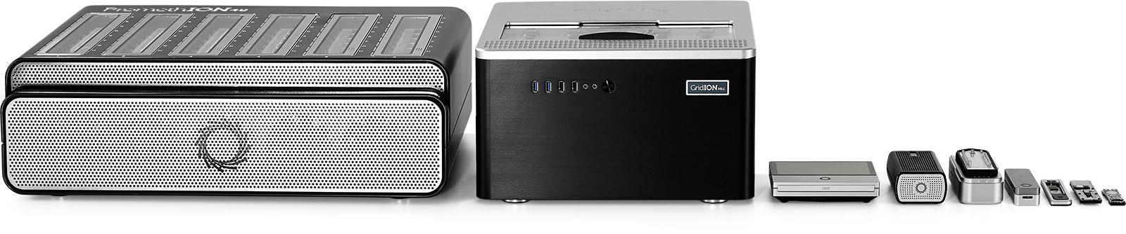
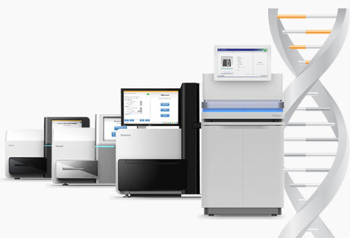
Sequencing Technologies
Oxford Nanopore (ONT)
PacBio
Illumina
Short reads: a few hundred base pairs and error rate of ∼0.1%
Long reads: thousands to millions of base pairs and error rate of 5–10%
Notes:
ONT, PacBio, Illumina
[CLICK] Based on the sequencing device, we obtain either short reads or long reads.

Slide 92
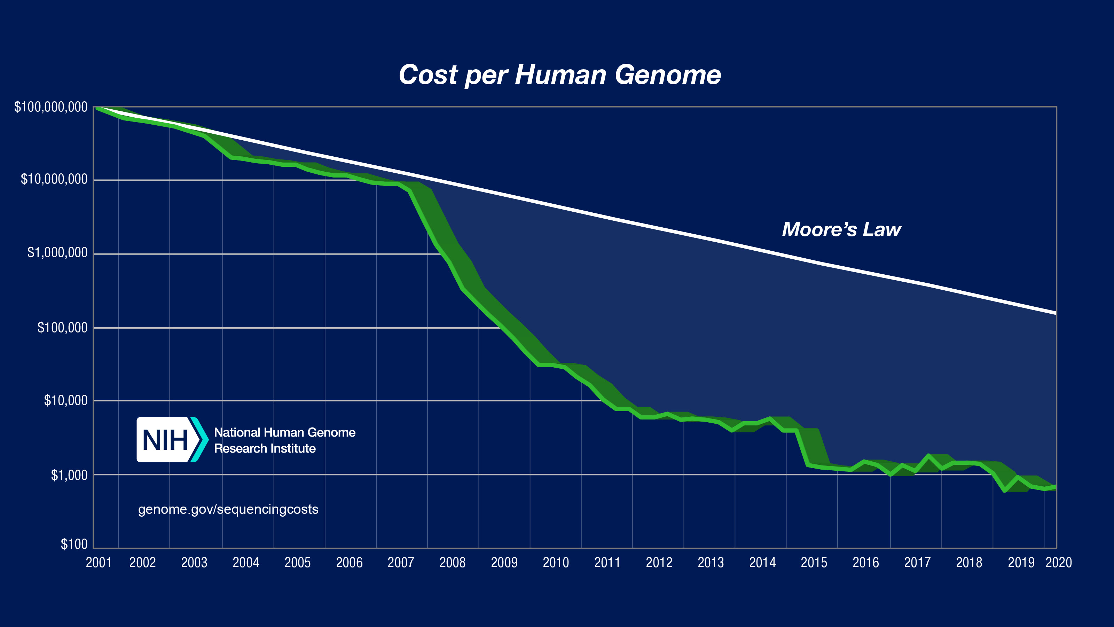
Current State of Sequencing (cont’d.)
*From NIH (https://www.genome.gov/about-genomics/fact-sheets/DNA-Sequencing-Costs-Data)
Notes:
However, the compute power doesn’t match up with this trend.
Modern sequencing machines generate read fragments at an exponentially higher rate than prior sequencing technologies, with their growth far outpacing the growth in computational power in recent years
For example, the Illumina NovaSeq 6000 system can sequence about 48 human whole genomes at 30× genome coverage (the av- erage number of times a genomic base is sequenced) in about two days. However, analyzing (performing mapping and variant calling) the sequencing data of a single human genome requires over 32 CPU hours on a 48-core Intel Xeon processor, 23 of which are spent on read mapping

Slide 93
Current State of Sequencing (cont’d.)
Computation is a bottleneck!
*From NIH (https://www.genome.gov/about-genomics/fact-sheets/DNA-Sequencing-Costs-Data)
Notes:
However, the compute power doesn’t match up with this trend.
Modern sequencing machines generate read fragments at an exponentially higher rate than prior sequencing technologies, with their growth far outpacing the growth in computational power in recent years
For example, the Illumina NovaSeq 6000 system can sequence about 48 human whole genomes at 30× genome coverage (the av- erage number of times a genomic base is sequenced) in about two days. However, analyzing (performing mapping and variant calling) the sequencing data of a single human genome requires over 32 CPU hours on a 48-core Intel Xeon processor, 23 of which are spent on read mapping

Slide 94
Genome Sequence Analysis
ACGTACCCCGT
TTTTTTTAATT
ACGAGCGGGT
GATACACTGTG
AAAAAAAAAA
Reads
CTAGGGACCTT
ACGACGTAGCT
Read Mapping, method of aligning the reads against the reference genome in order to detect matches and variations.
De novo Assembly, method of merging the reads in order to construct the original sequence.
Reference
Genome
Original
Sequence
Reads
Mapped Reads
Reads
Assembled Reads
Notes:
When I say analysis, what do I mean. What I mean is how we will analyze these reads.
They can then be analyzed following two different approaches:
First one is Read mapping and it is the process of aligning the reads against the reference genome to detect sequencing errors and variations in the sequenced genome.
And the second approach is de novo assembly, which is the method of combining the reads to construct the original sequence when a reference genome does not exist.

Slide 95
Read Mapping Pipeline
Reference genome
Indexing
(Pre-processing step to generate index of reference)
Hash-table based index
Reads
Seeding
(Query the index)
Potential mapping
locations
Reference
segment
Pre-Alignment Filtering
(Filter out dissimilar sequences)
Query read
Remaining potential mapping locations
Read Alignment
(Perform distance/score calculation & traceback)
Optimal alignment
Notes:
Let’s look at the read mapping pipeline. Read mapping can be seen as a four-step process (i.e., seed-and-extend).
First, read mapping starts with indexing the reference genome. This index contains all possible fixed-length substrings as the keys, and the exact match locations of these substrings in the reference genome as values. Second, seeding queries the index structure for determining potential mapping locations of each read in the reference genome using substrings (i.e., seeds) from each read.
Third, pre-alignment filtering uses filtering heuristics to examine the similarity between every read and its potential matching segment on the reference genome that are identified in the second step. Goal is to eliminate most of the dissimilar sequences to decrease the number of required alignments. Fourth, for all of the non-filtered candidate mapping locations, read alignment (i.e., seed-extension) step performs a dynamic programming based alignment to determine the best location of the query read. As part of this step, traceback operation between the reference segment and the query is performed in order to find the optimal alignment.

Slide 96
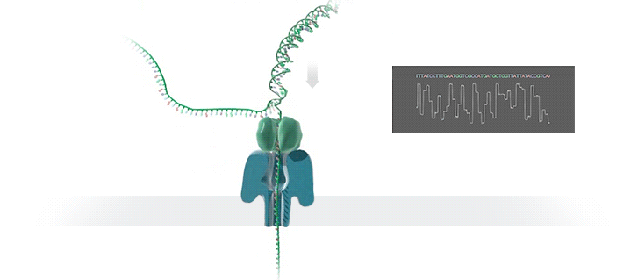
Genome Assembly Pipeline Using Long Reads
With the emergence of long read sequencing technologies, de novo assembly becomes a promising way of constructing the original genome.
Raw signal data
Basecalling
(Translates signal data into bases: A,C,G,T)
DNA reads
Read-to-Read Overlap Finding
(Finds pairwise read alignments for each pair of read)
Overlaps
Assembly
Assembly
(Traverses the overlap graph & constructs the draft assembly)
Draft assembly
Read Mapping
(Maps the reads to the draft assembly)
Mappings of reads against draft assembly
Improved assembly
Polishing
(Polishes the draft assembly & increases the accuracy)
Notes:
With the emergence of long read sequencing technologies (i.e., ONT and PacBio), de novo assembly becomes a promising way of constructing the original genome since a long read can span an entire repetitive sequence and enable continuous and complete assemblies.
The output of nanopore sequencers is raw signal data that represents changes in electric current when a DNA strand passes through nanopore. Thus, the pipeline starts with the raw signal data. The first step, basecalling, translates this raw signal output of MinION into bases (A, C, G, T) to generate DNA reads. It is important to note that basecalling is the only step unique to nanopore sequencing, and the rest of the steps are applicable for both of the long read sequencing technologies (ONT and PacBio).
The second step computes all pairwise read alignments between each pair of reads, called read-to-read overlaps. The third pipeline step, genome assembly, generates an overlap graph, where each node denotes a read and each edge represents the overlaps between the corresponding two nodes. Then it traverses this overlap graph, produces the layout of the reads and then constructs a draft assembly. To increase the accuracy of the assembly, further polishing, i.e., post-assembly error correction, may be required, but it is optional. The fourth step of the pipeline is mapping the original basecalled reads to the generated draft assembly from the previous step (i.e., read mapping). The fifth and final step of the pipeline is polishing the assembly with the help of mappings from the previous step.

Slide 97
Our Contributions
Analyze the tools in multiple dimensions: accuracy, performance, memory usage, and scalability
Reveal new bottlenecks and trade-offs
First study on bottleneck analysis of nanopore sequence analysis pipeline on real machines
Provide guidelines for practitioners
Provide guidelines for tool developers
Notes:
In this work, we analyze the tools associated with the multiple steps in the genome assembly pipeline using nanopore sequence data in terms of accuracy, speed, memory efficiency and scalability.
Reveal bottlenecks and trade-offs that different combinations of tools and different underlying systems lead to
This is the first study on bottleneck analysis of nanopore sequence analysis pipeline on real machines
Provide guidelines for practitioners, such that they can determine the appropriate tools and tool combinations that can satisfy their goals, and
Provide guidelines for tool developers, such that they can make design choices to improve current and future tools.

Slide 98
Key Findings
Laptops are becoming a popular platform for running genome assembly tools, as the portability of a laptop makes it a good fit for in-field analysis
Greater memory constraints
Lower computational power
Limited battery life
Memory usage is an important factor that greatly affects the performance and the usability of the tool
Data structure choices that increase the memory requirements
Algorithms that are not cache-efficient
Not keeping memory usage in check with the number of threads
Scalability of the tool with the number of cores is an important requirement. However, parallelizing the tool can increase the memory usage
Not dividing the input data into batches
Not limiting the memory usage of each thread
Dividing the dataset instead of the computation between simultaneous threads
Notes:
We have 21 observations in our paper, but let me highlight 3 key findings we made
Laptops are becoming a popular platform for running genome assembly tools, as the portability of a laptop makes it a good fit for in-field analysis
Greater memory constraints,
Lower computational power, and
Limited battery life
Memory usage is an important factor that greatly affects the performance and the usability of the tool
Data structure choices that can minimize the memory requirements
Cache-efficient algorithms
Keeping memory usage in check with the number of threads
Scalability of the tool with the number of cores/threads is an important requirement.
However, parallelizing the tool can increase the memory usage.
Dividing the input data into batches
Limiting the memory usage of each thread
Dividing the computation instead of the dataset between simultaneous threads

Slide 99
Key Findings
Goal 1:
High-performance and low-power
Laptops are becoming a popular platform for running genome assembly tools, as the portability of a laptop makes it a good fit for in-field analysis
Greater memory constraints,
Lower computational power
Limited battery life
Memory usage is an important factor that greatly affects the performance and the usability of the tool
Data structure choices that can minimize the memory requirements
Cache-efficient algorithms
Keeping memory usage in check with the number of threads
Scalability of the tool with the number of cores is an important requirement. However, parallelizing the tool can increase the memory usage.
Dividing the input data into batches
Limiting the memory usage of each thread
Dividing the computation instead of the dataset between simultaneous threads
Goal 2:
Memory-efficient
Goal 3:
Scalable/highly-parallel

Slide 100

Nanopore Sequencing & Tools
Damla Senol Cali, Jeremie S. Kim, Saugata Ghose, Can Alkan, and Onur Mutlu. "Nanopore Sequencing Technology and Tools for Genome Assembly: Computational Analysis of the Current State, Bottlenecks and Future Directions." Briefings in Bioinformatics (2018).
BiB Version arXiv Version
BiB version
arXiv version

